Slide 1
T1International
Survey 2022 - Data cleaning & initial silo analyses
Axel Thieffry November 2022

Slide 2
Content
Simplification of question names
Data cleaning: cumulative filtering
Standardise costs to USD
Uncomplete records
Silo analyses

Slide 3
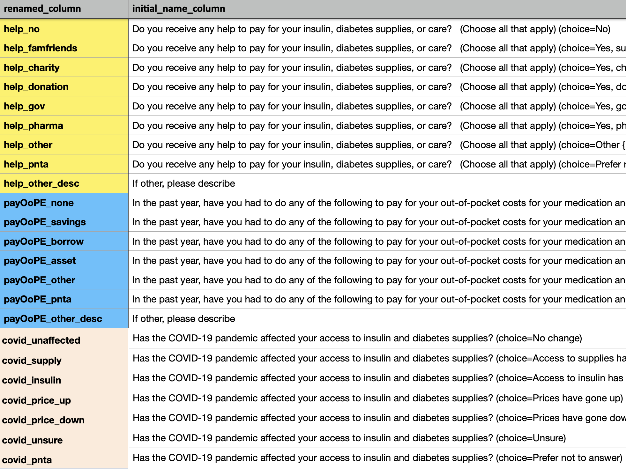
Simplification of question names
for easier data handling
Available in a spreadsheet
Will appear in draft figures
Will be polished in final figures

Slide 4
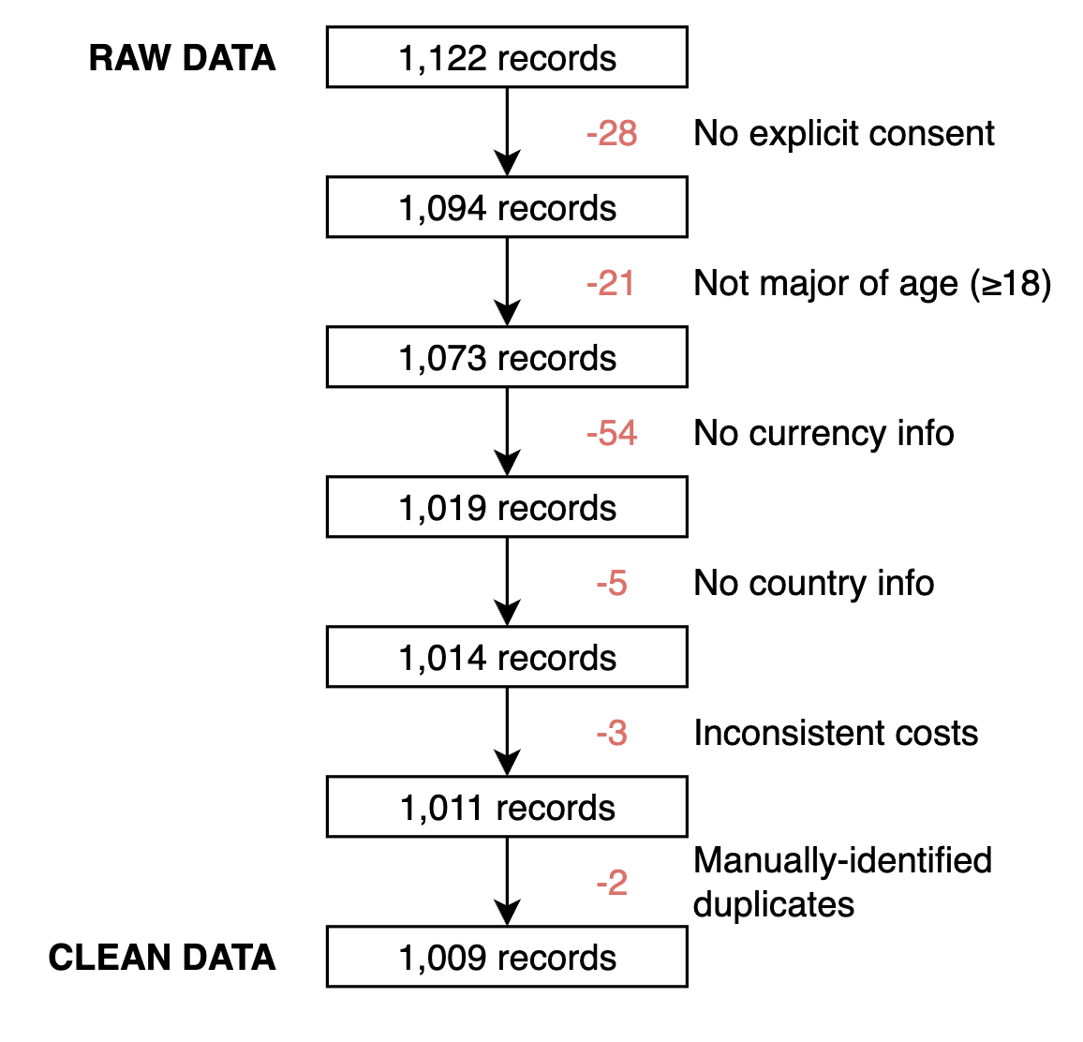
Data filtering
Updated Feb. 2023 ✅
Cumulative filtering (top to bottom): not absolute numbers as some entires might have been already discarded from previous step(s)

Slide 5

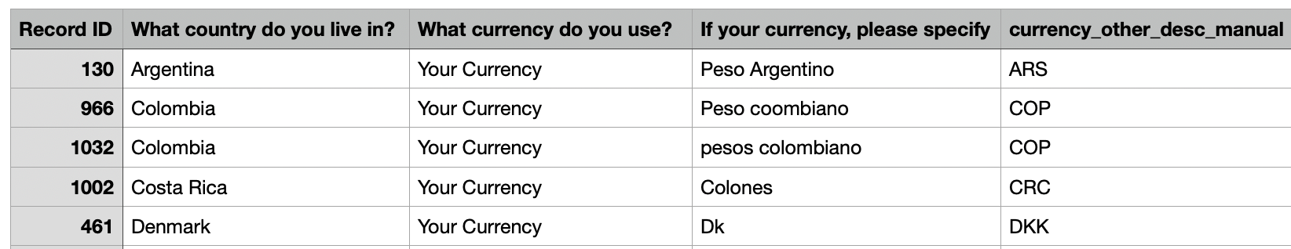
Standardise costs to USD
Note: - direct references to data are displayed in green - links are display in blue
a. currency extraction
Currency symbol (ISO 4217, ex. “(GBP)”) extraction strategy: 1. If declared from drop-down menu: directly from answer 2. If other currency (“Your Currency”): taken from description after manual curation
Manual curation: - New column in raw data (see example below), for 112 cases - Country info used to resolve ties

Slide 6
Standardise costs to USD
b. currency conversion
Conversion to USD uses current FX rates from the World Bank API (via the priceR package)
All initial cost-related columns with format: cost_xxx
All USD-converted columns renamed with format: usd_xxx

Slide 7
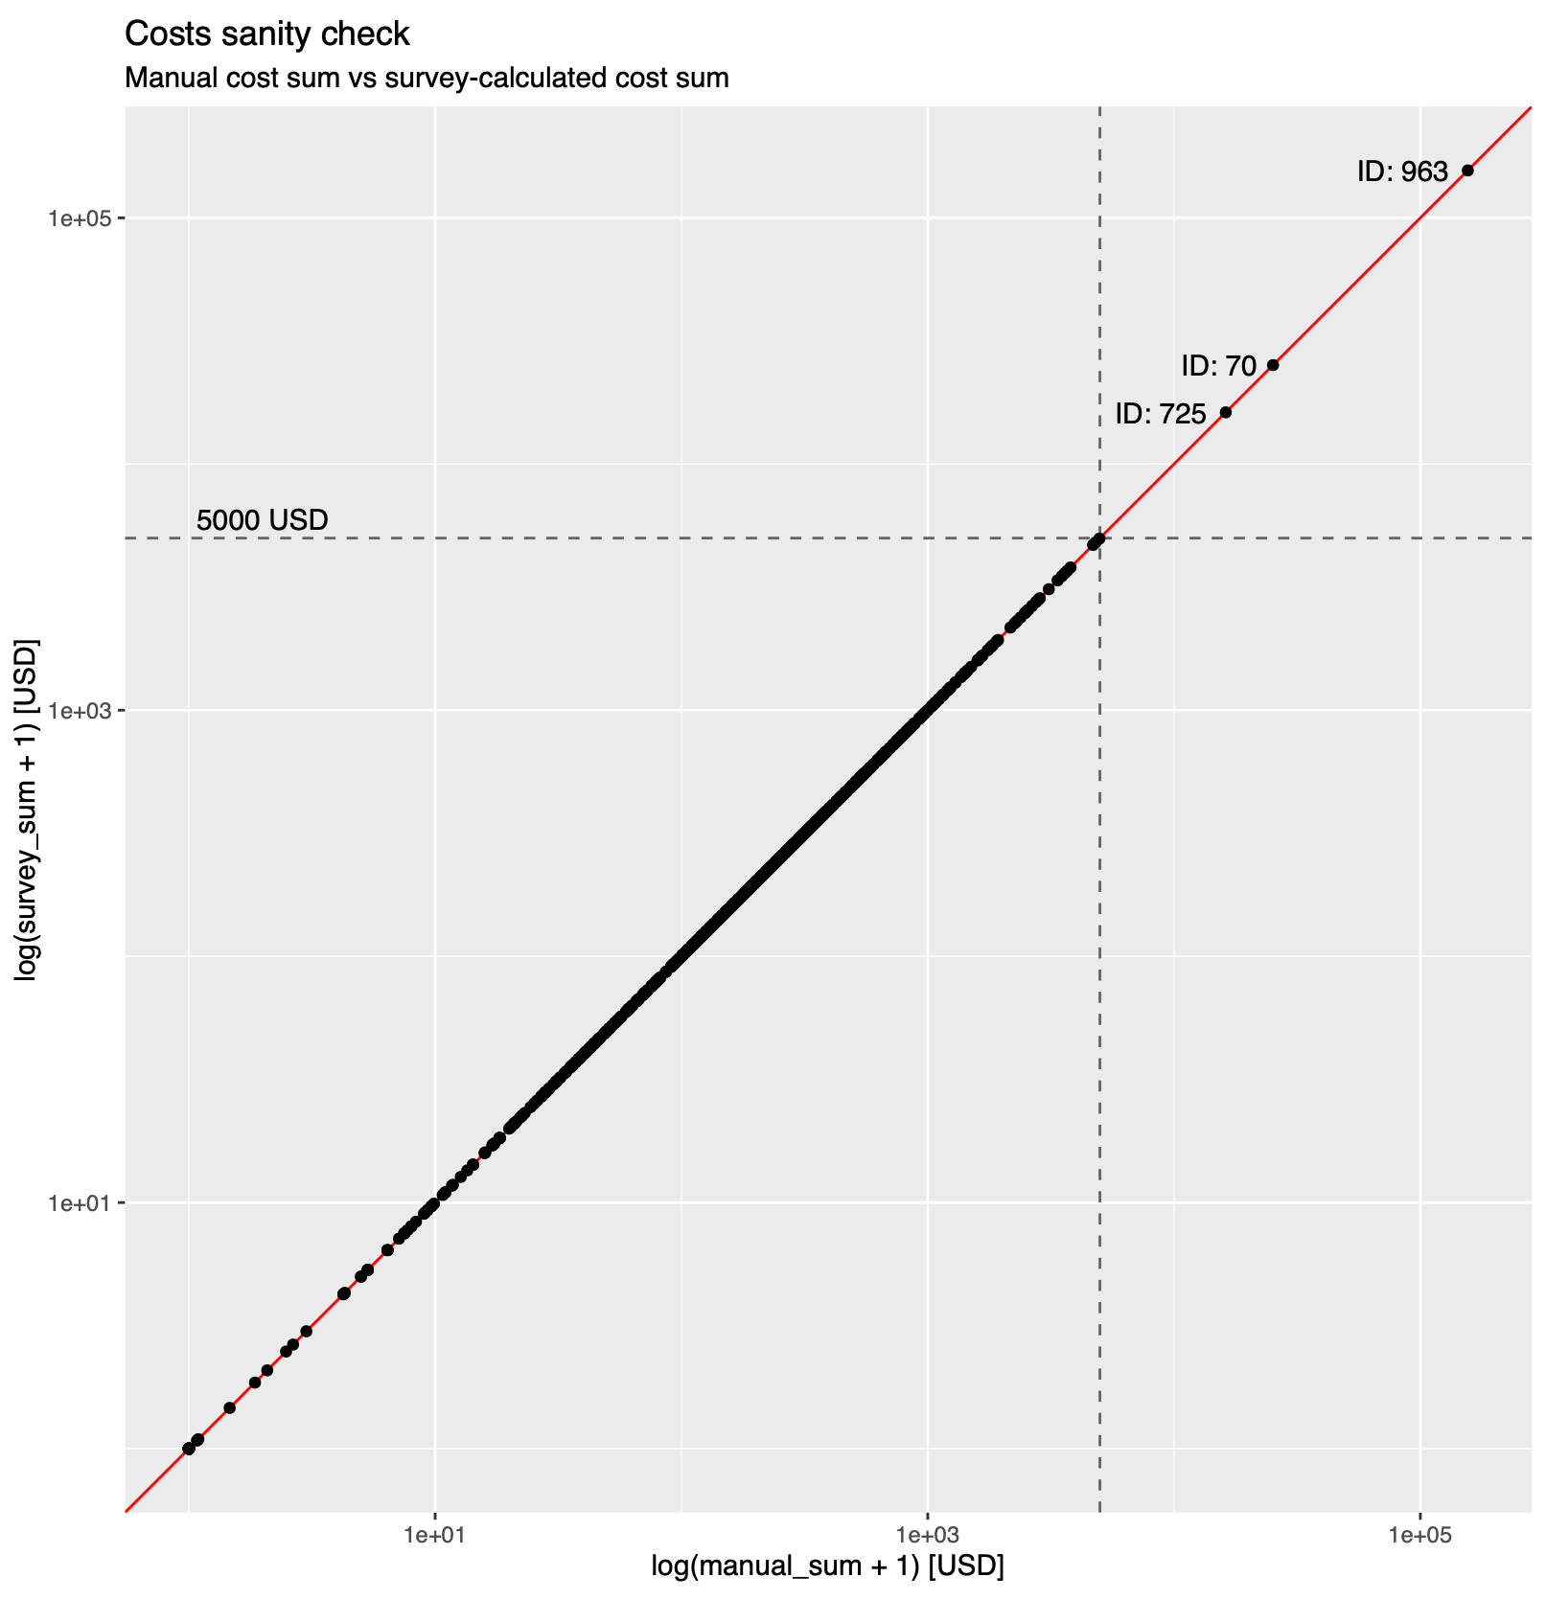

Standardise costs to USD
Updated Feb. 2023 ✅
c. sanity check
Manual sum of Out-of-Pocket Expenses (OoPEs) vs Survey’s automatic calculation
Definition: $OoPE_{total}=∑(insulin_{[sa+la+mix+other]},pump,bg,cgm,penneedles)$
removed
=> Survey automatic calculation is good
=> 3 outliers removed

Slide 8
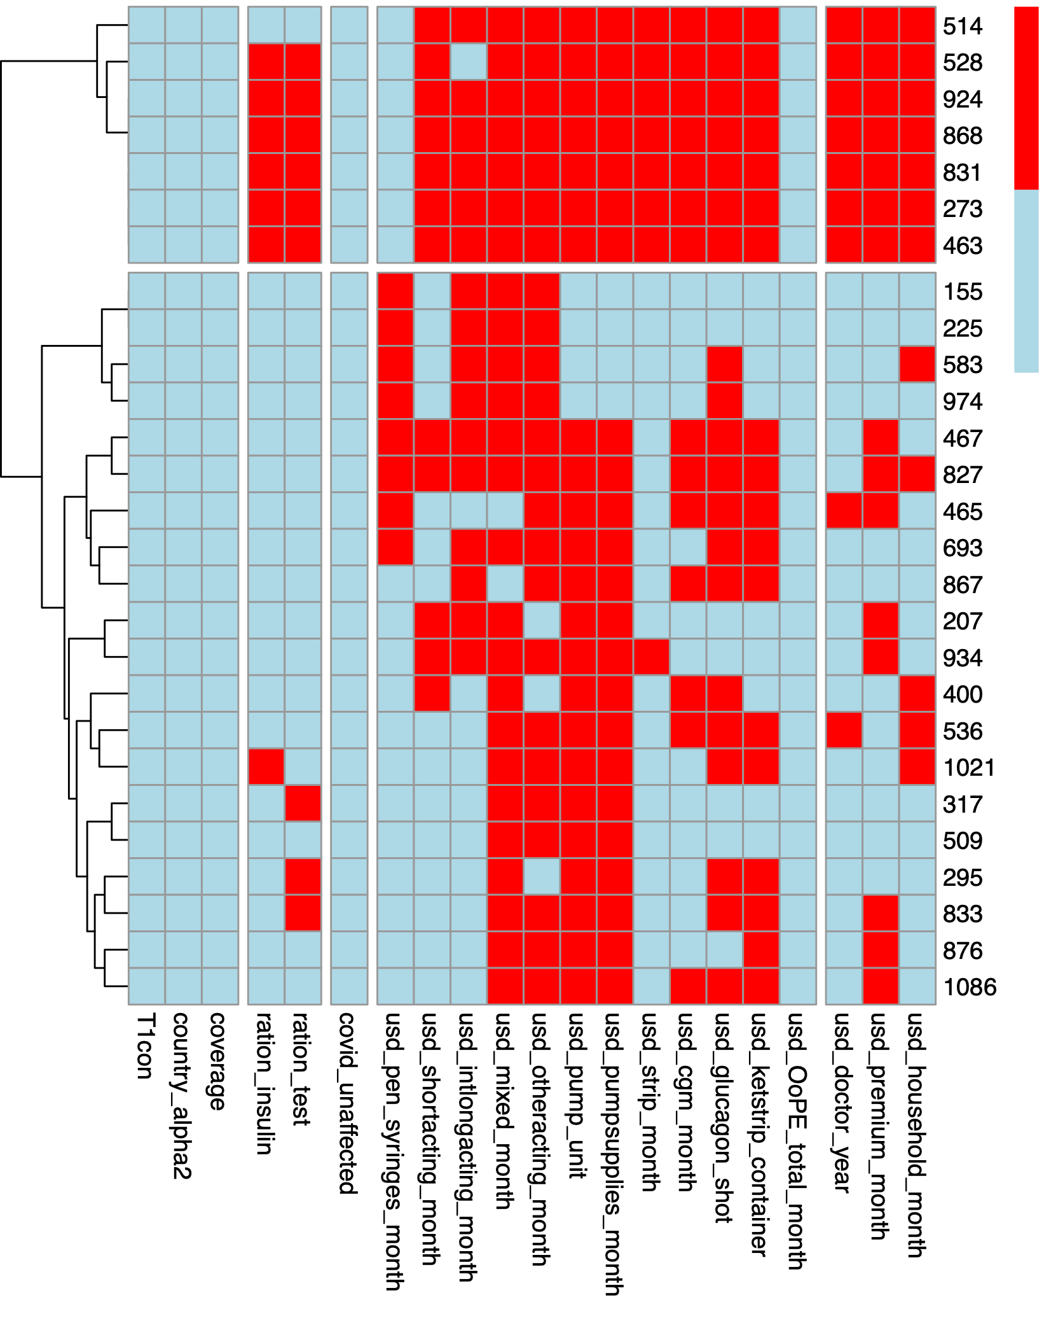
Uncomplete records
misc.
ration
COVID
OoPEs
other costs
↴
missing
Overview
answered
Currently 27 records are marked as incomplete
Tentative set of important* questions: - T1 connection, country, healthcare coverage - rationing of insulin and BG testing - all T1D-related costs (OoPEs) - other cost-related questions (doctor, premium, household)
=> Keeping the 27 incomplete records won’t have dramatic consequences as many of the completed records also failed to inform on many of these questions
=> If kept, final dataset will comprise 1,011 answers
* arbitrarily-defined as per the intended main goals of the survey e.g. costs, COVID, and rationing

Slide 9
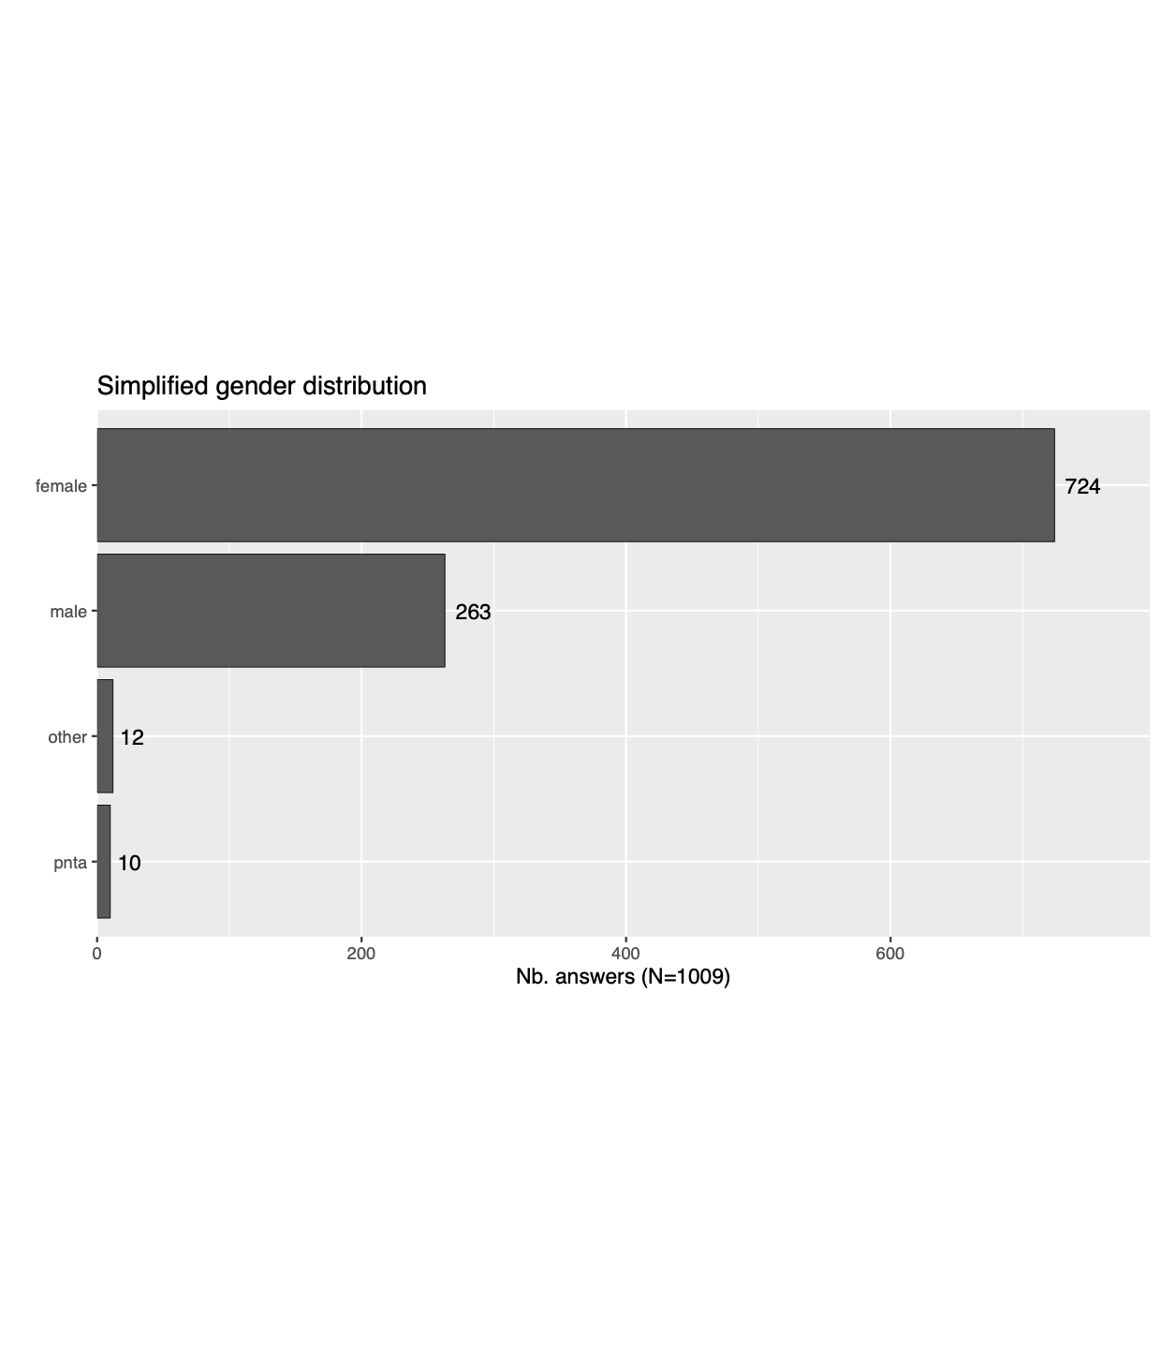
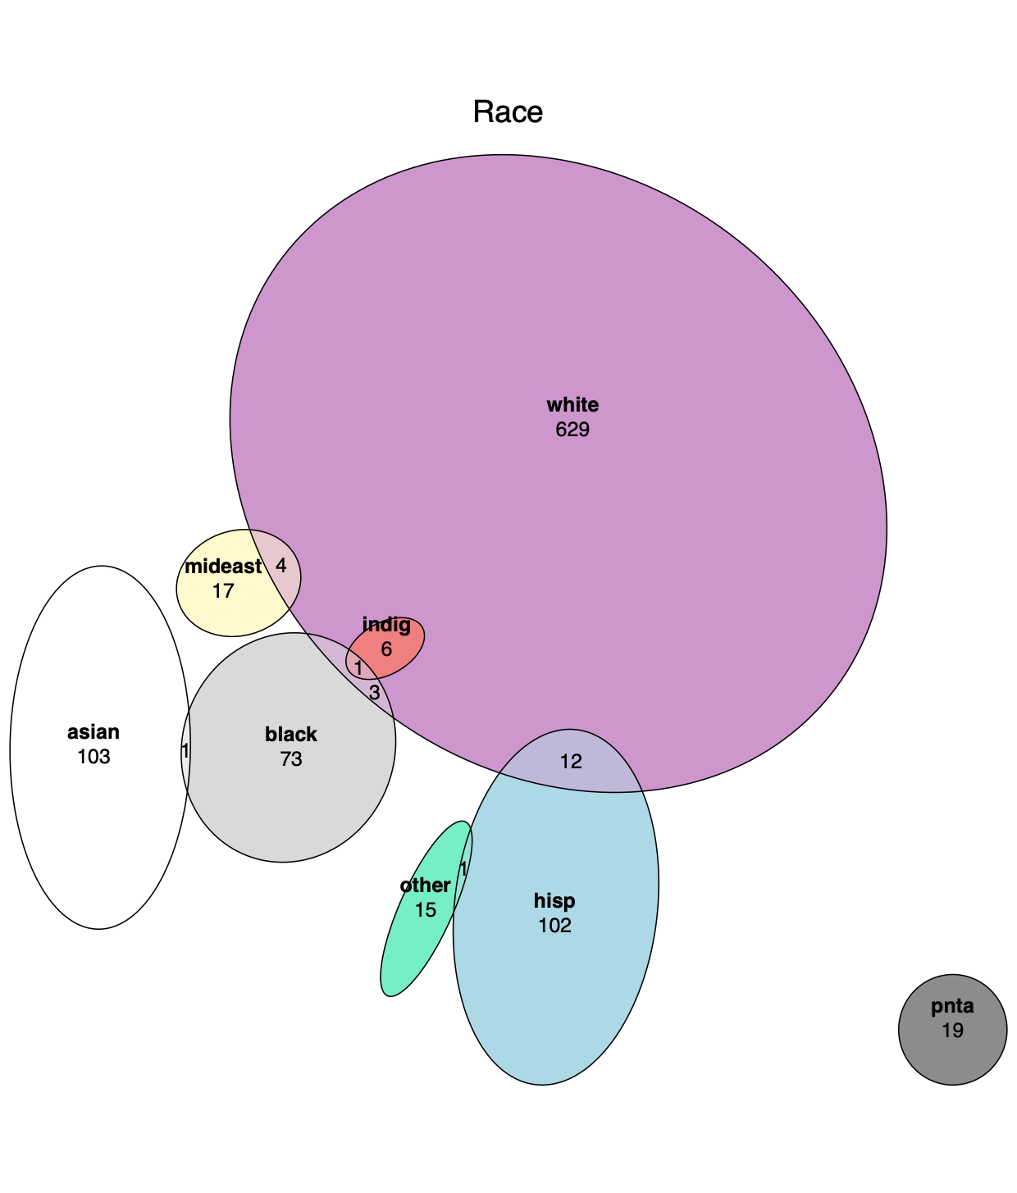
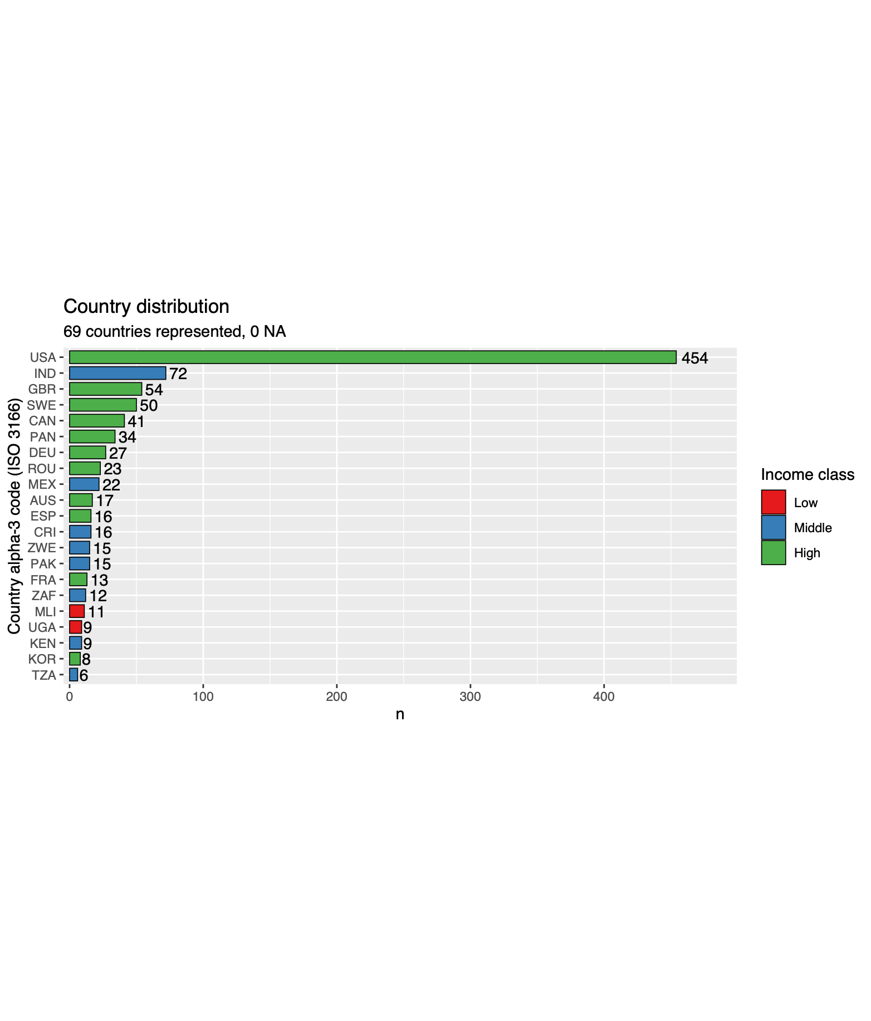
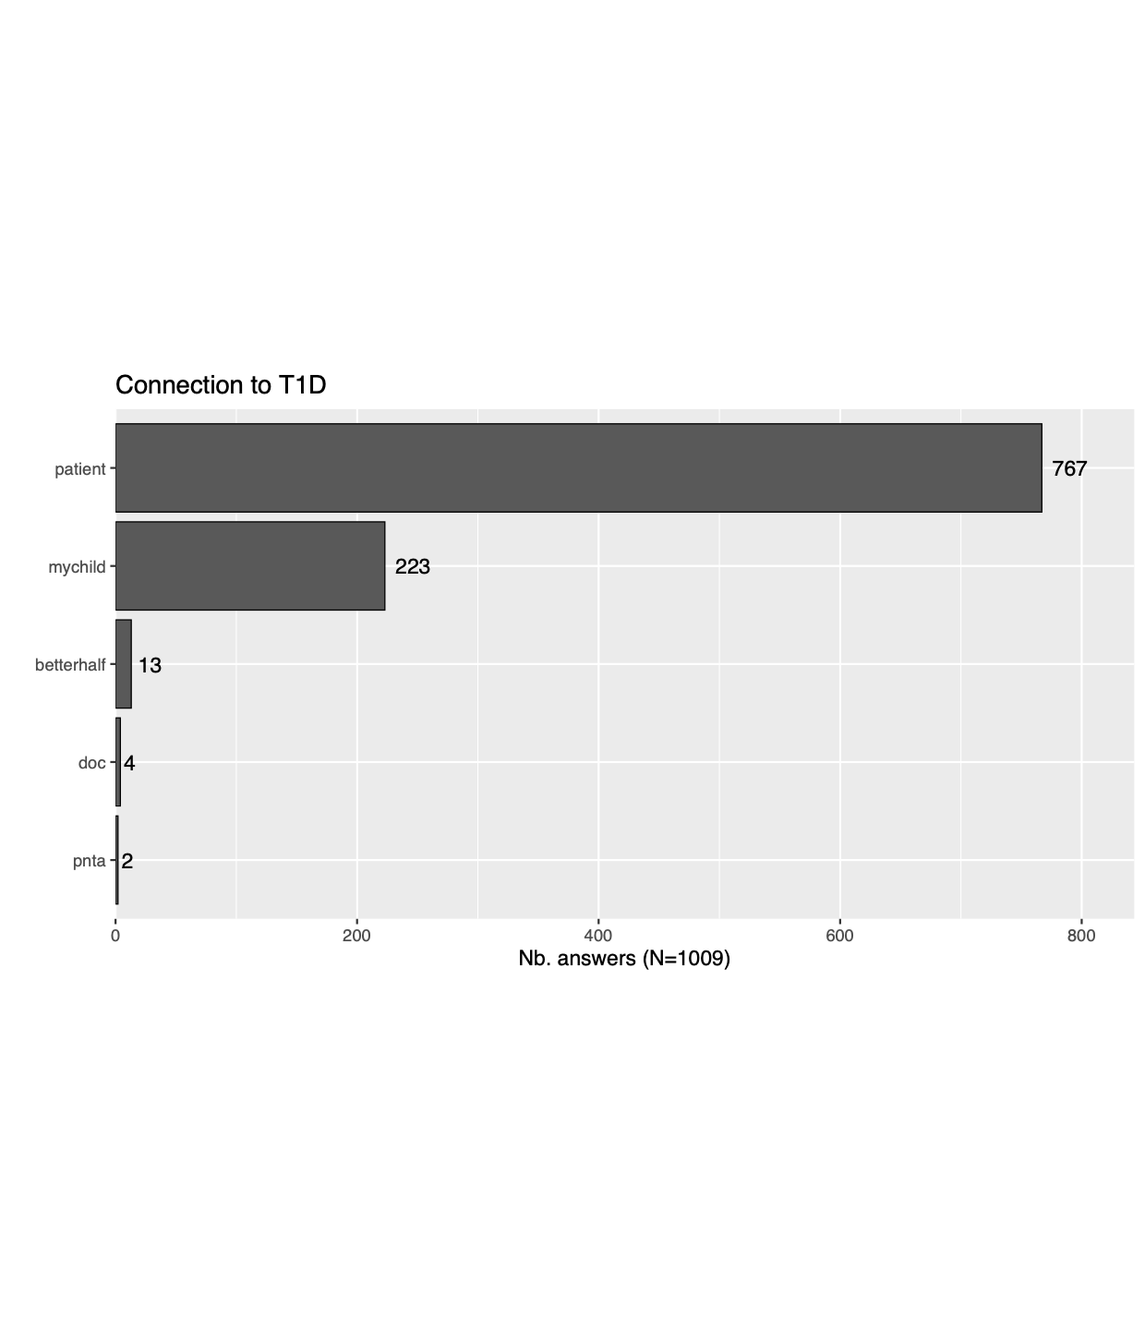
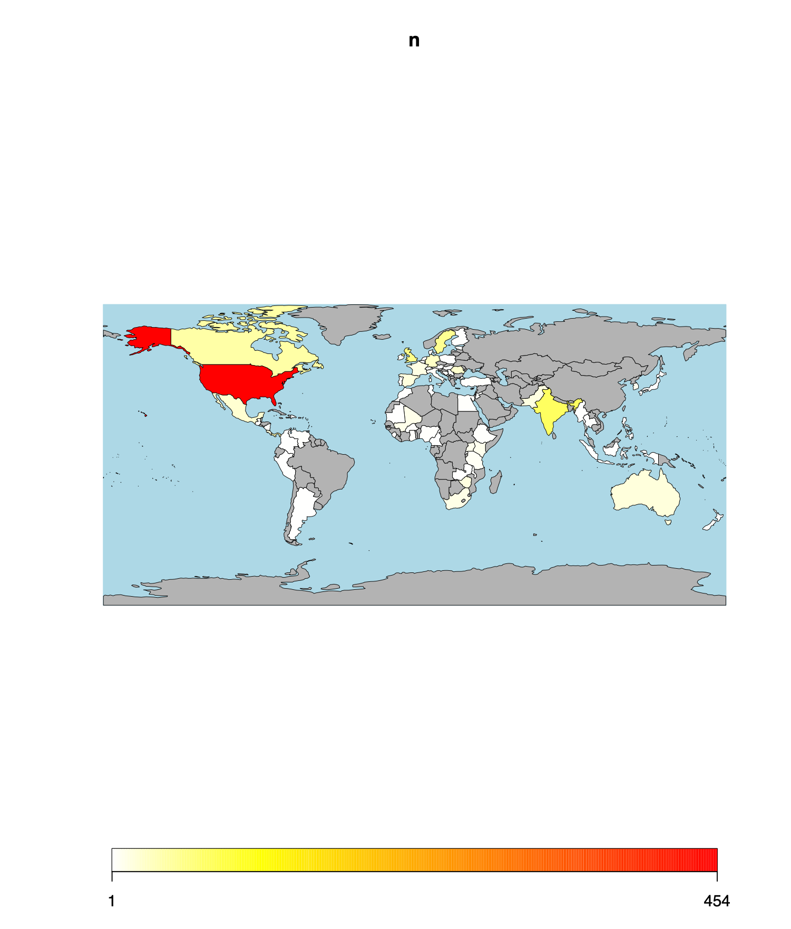
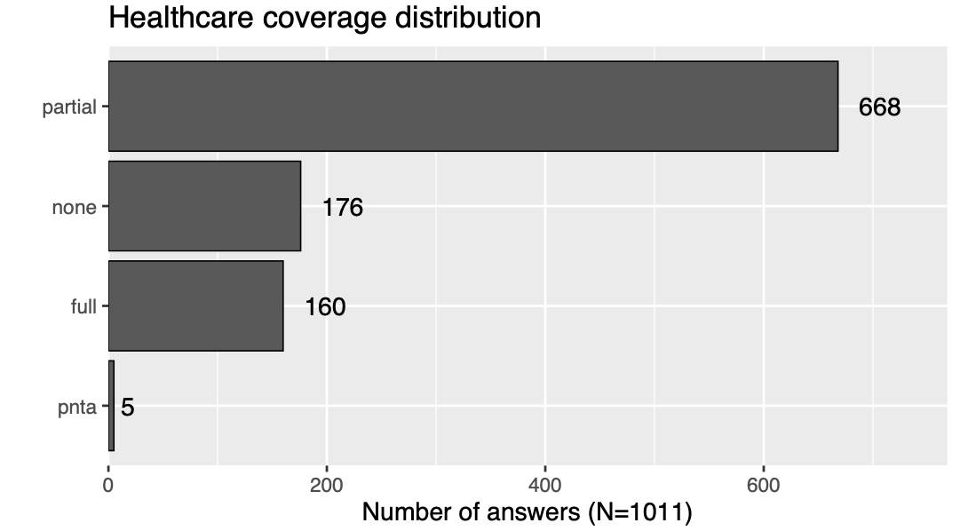

Silo analyses
Updated Feb. 2023 ✅
Demographics & misc
⚠️ Note: Euler diagrams (cfr. above) are comparable to classical Venn diagrams except: - Areas are proportional to the number of members in a set - Must be interpreted as an overview rather than an exact representation of the data reality: all set intersection are not always possible to represent geometrically

Slide 10
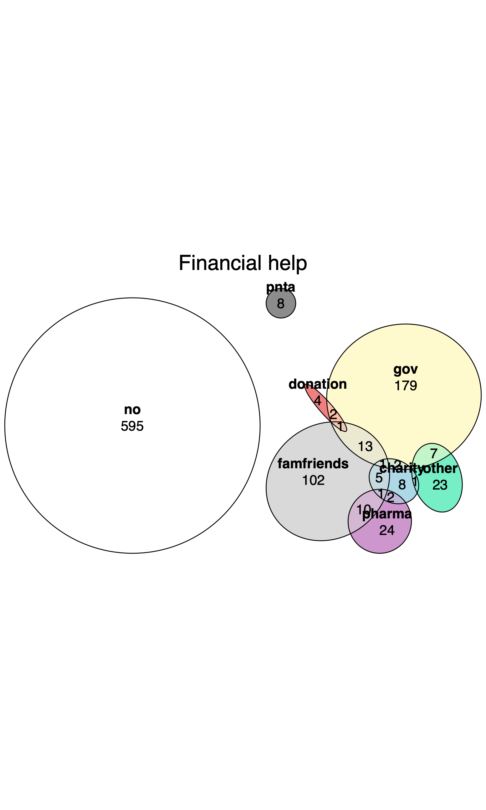
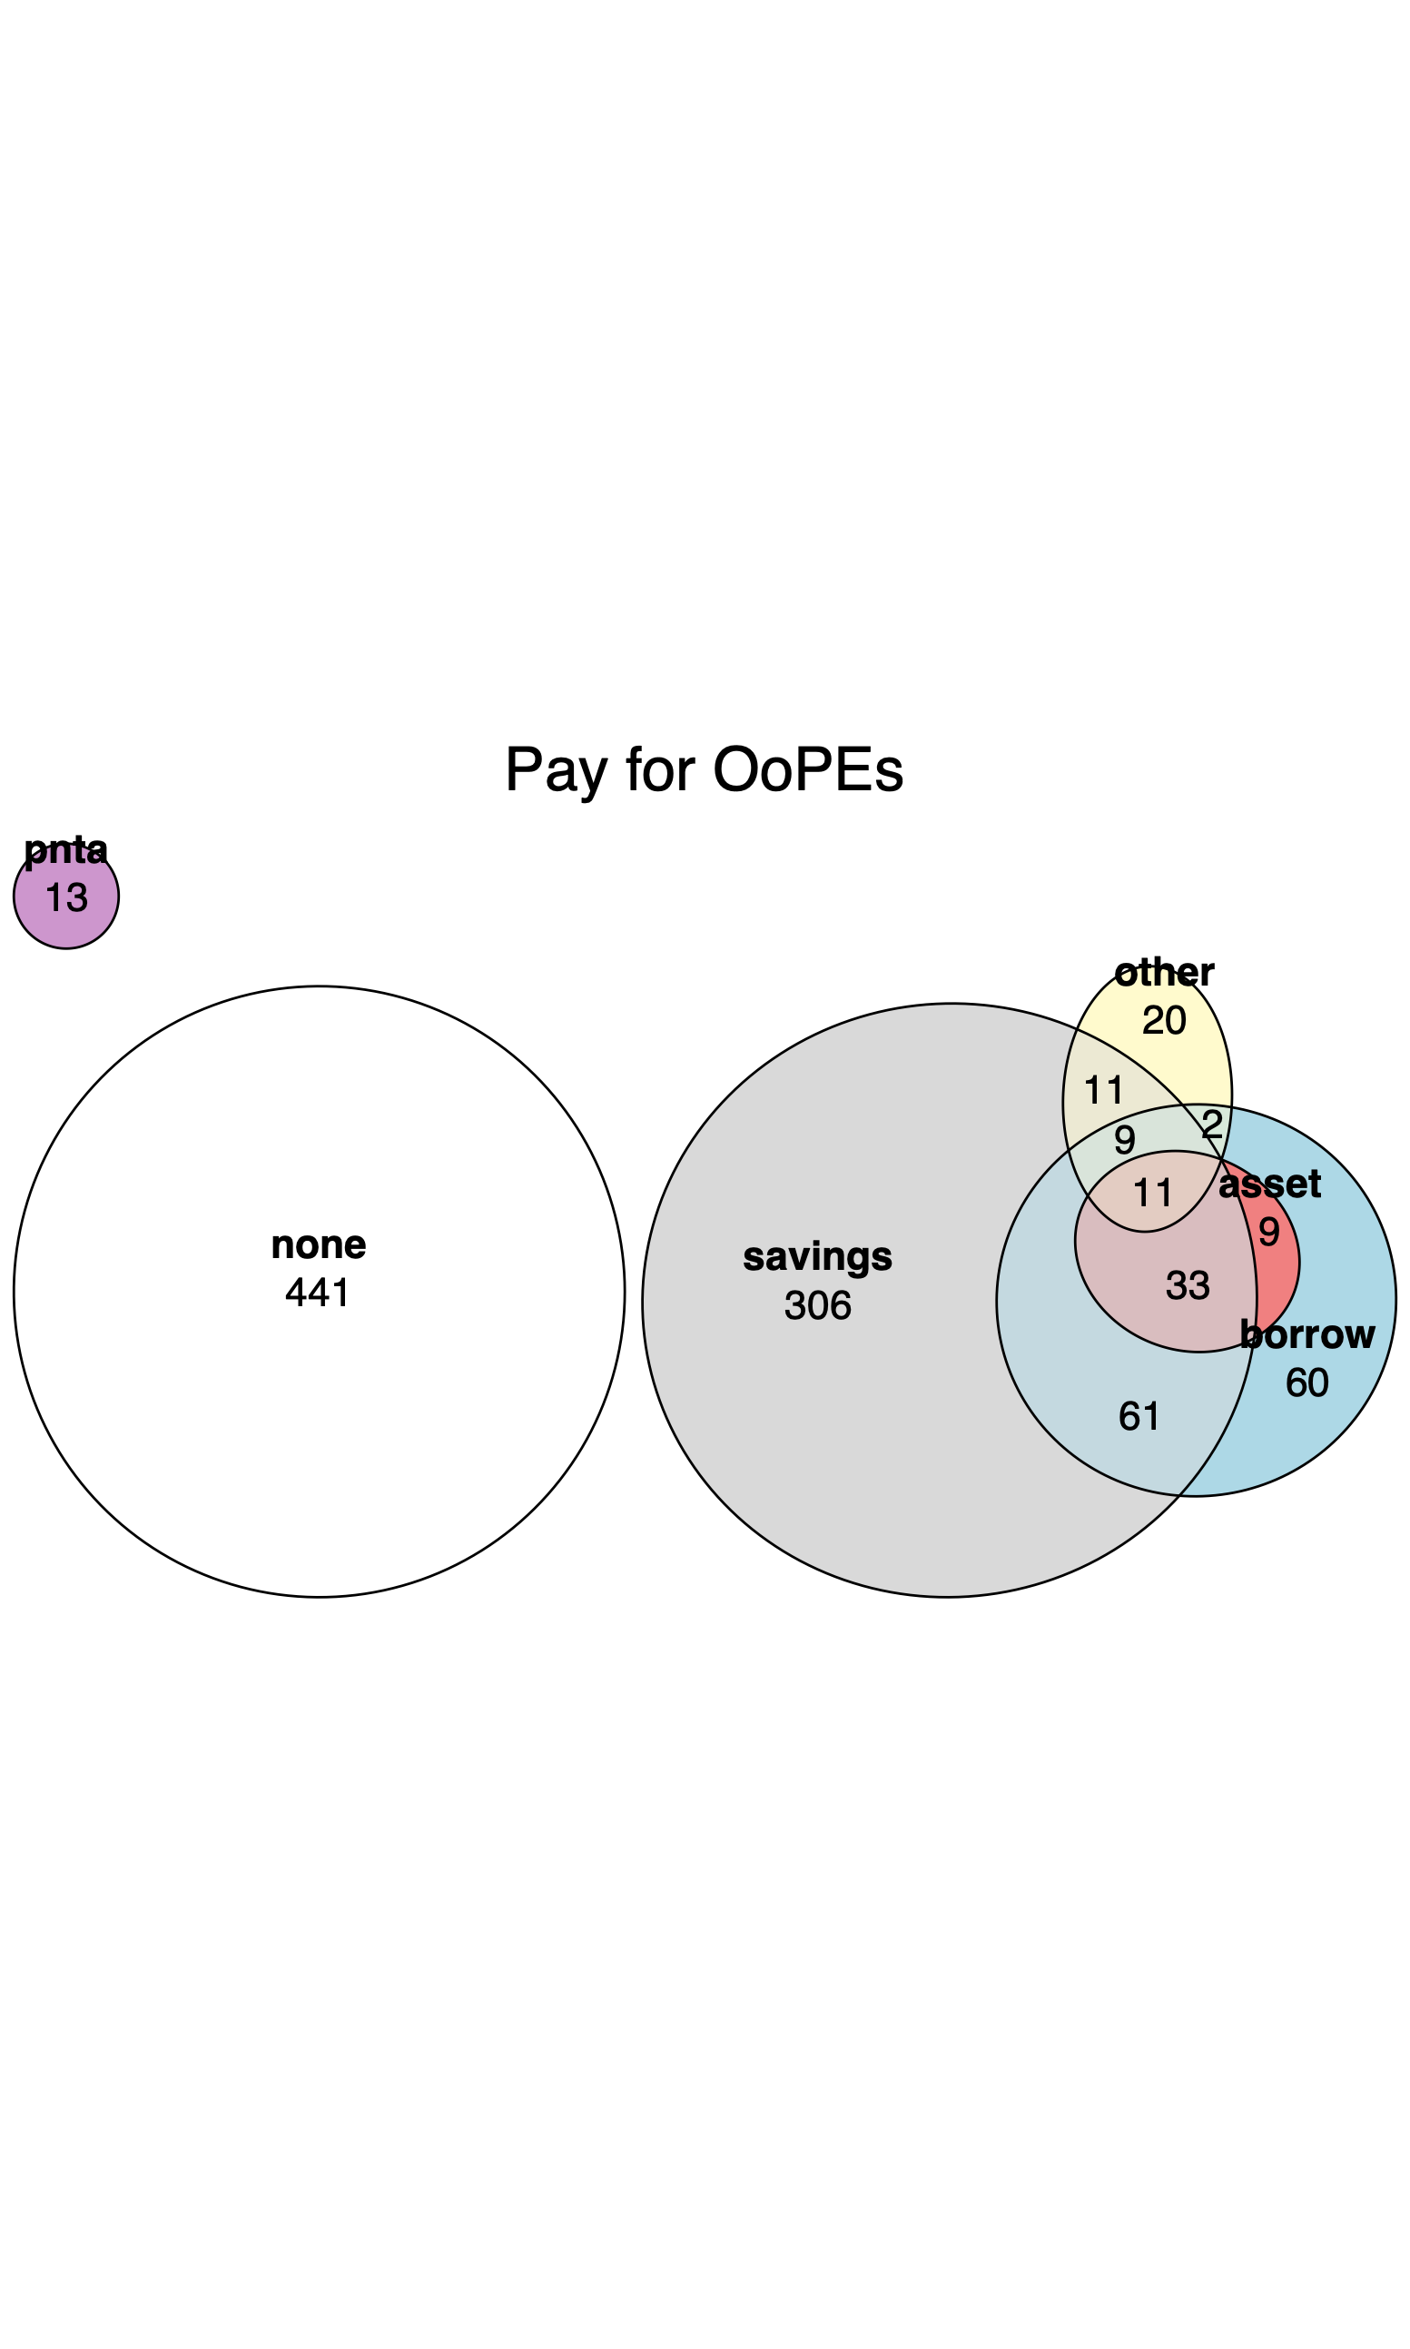
Silo analyses
Updated Feb. 2023 ✅
Financing

Slide 11
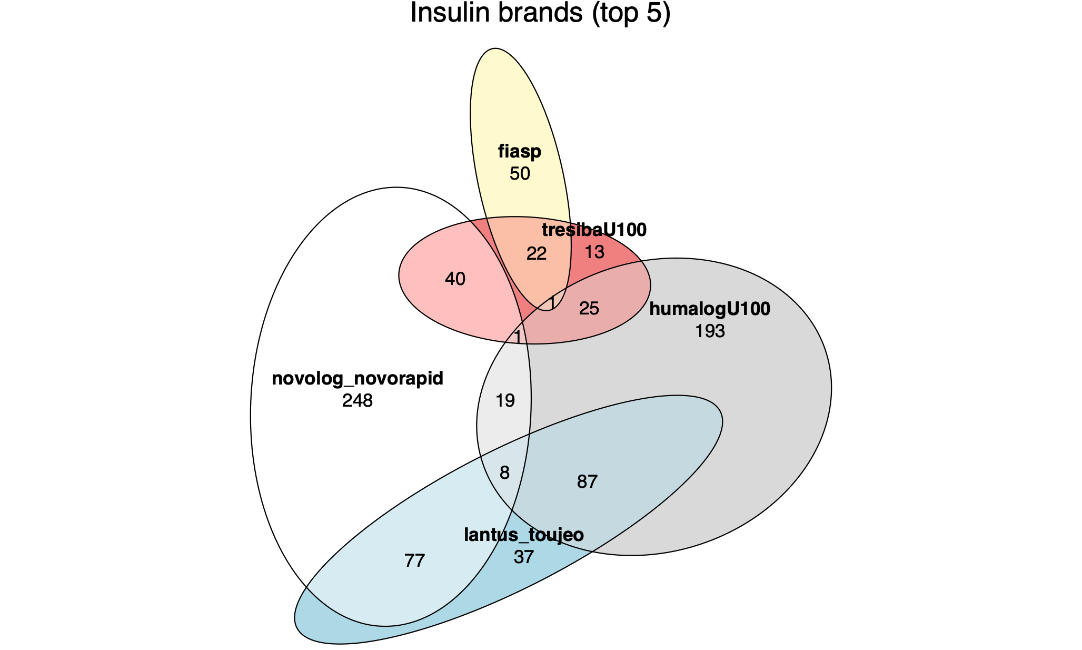
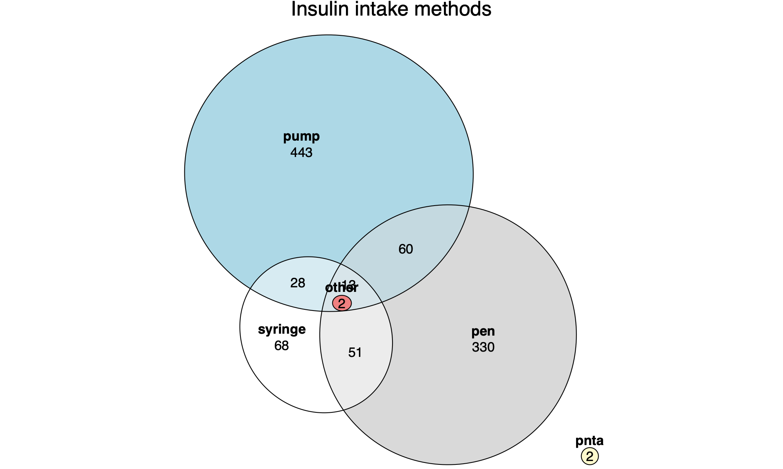
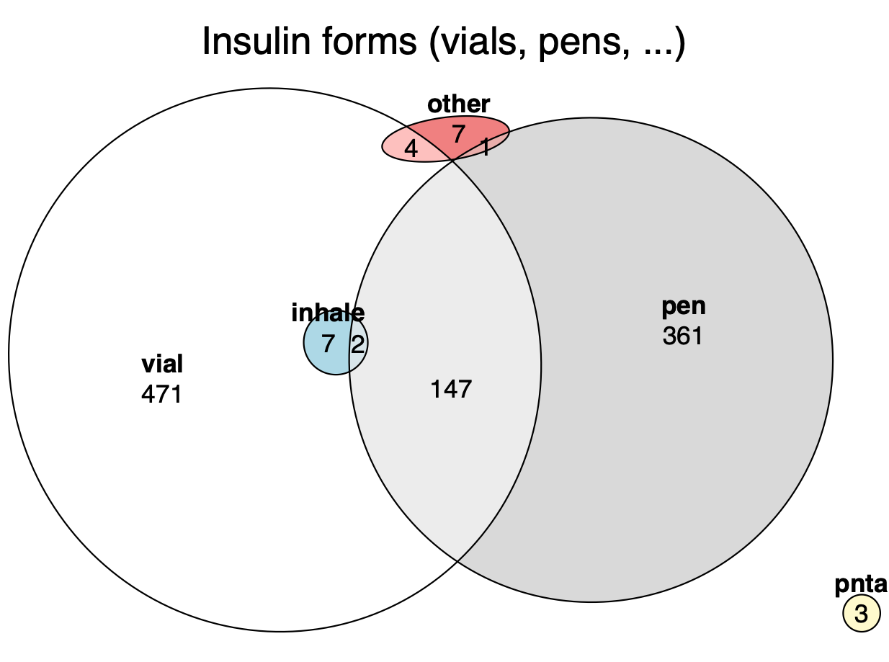
Silo analyses
Updated Feb. 2023 ✅
Insulin

Slide 12
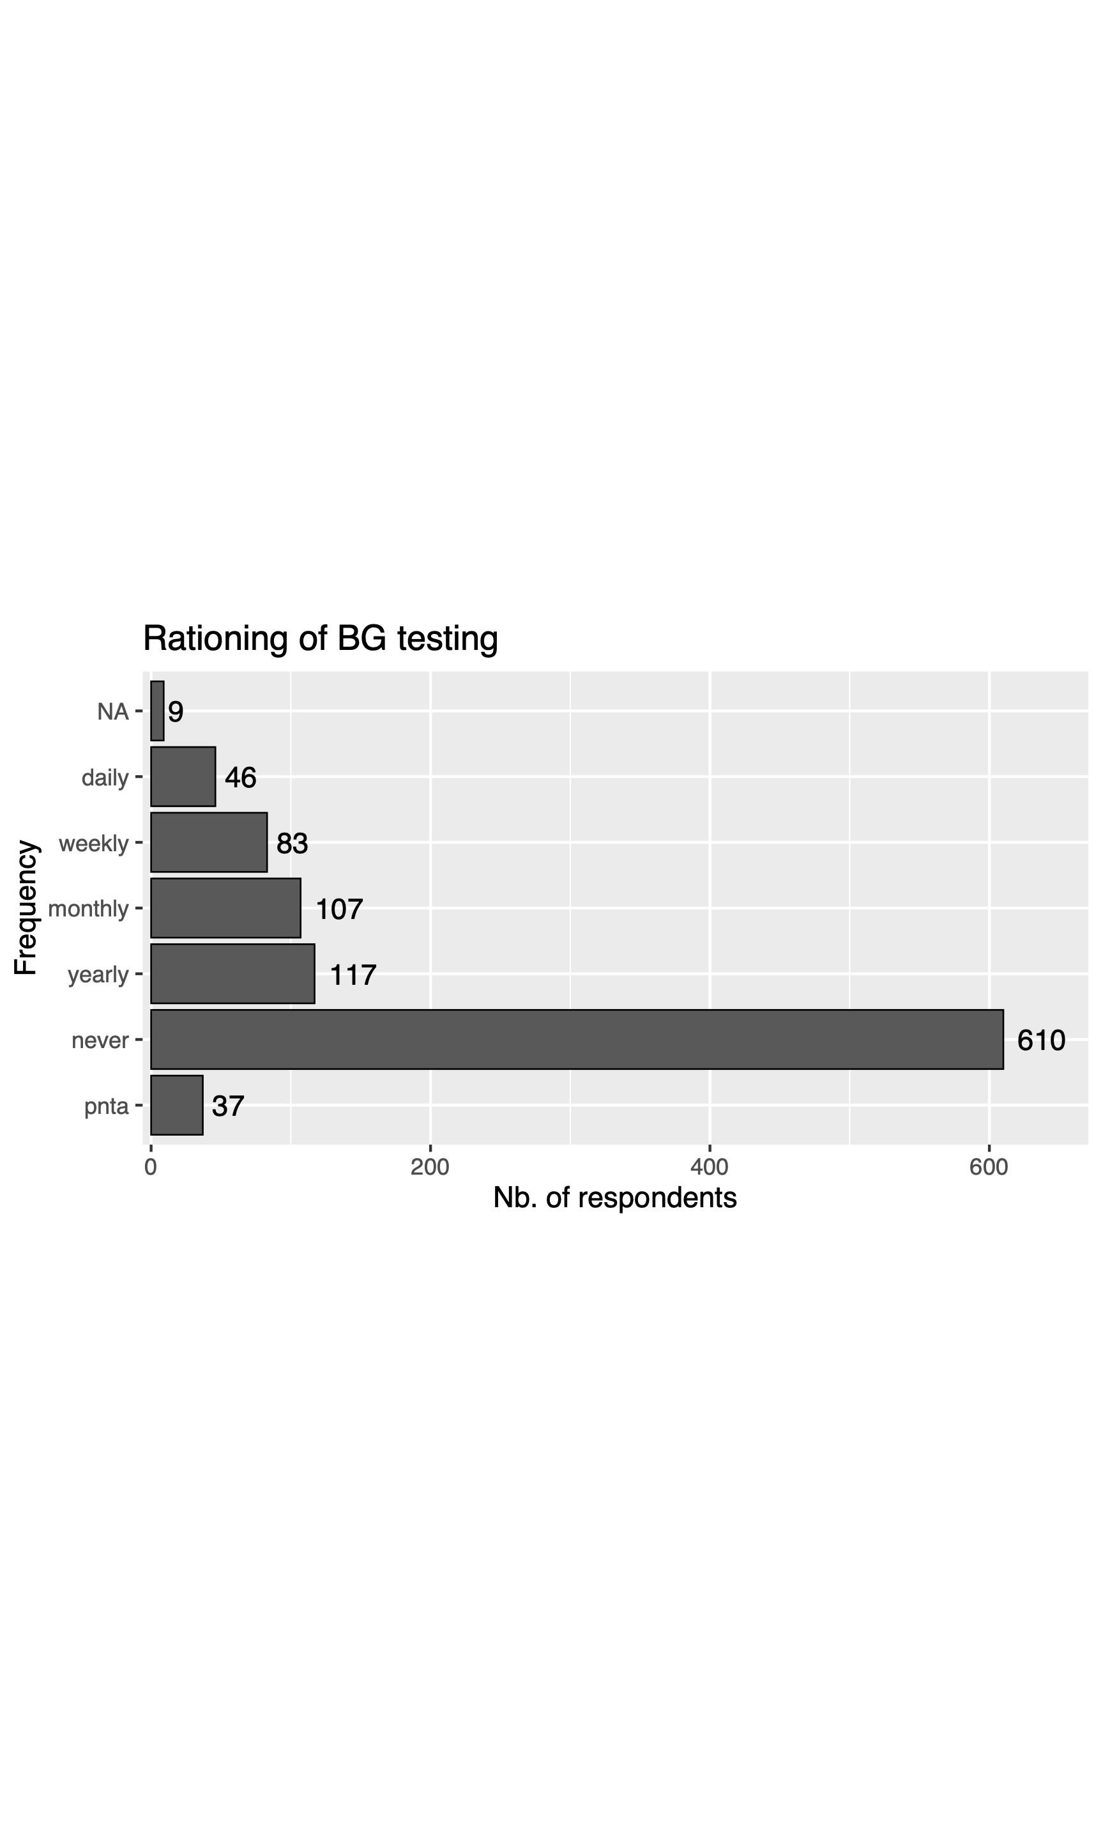
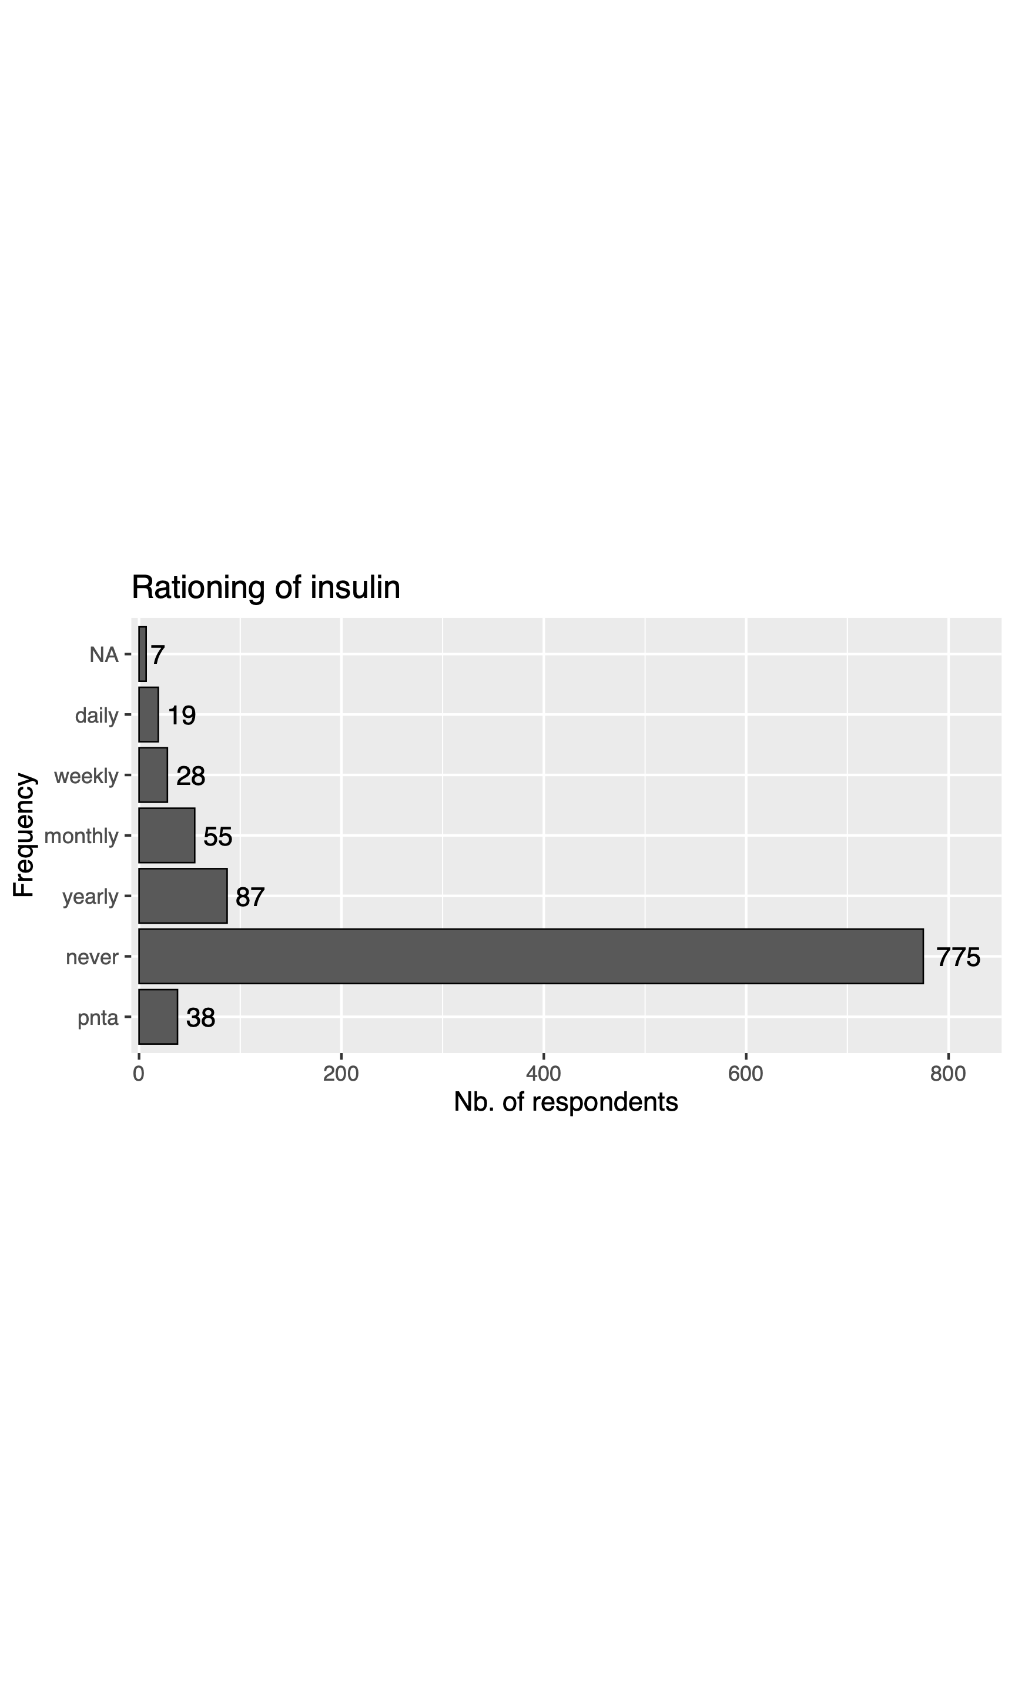
Silo analyses
Updated Feb. 2023 ✅
Rationing

Slide 13
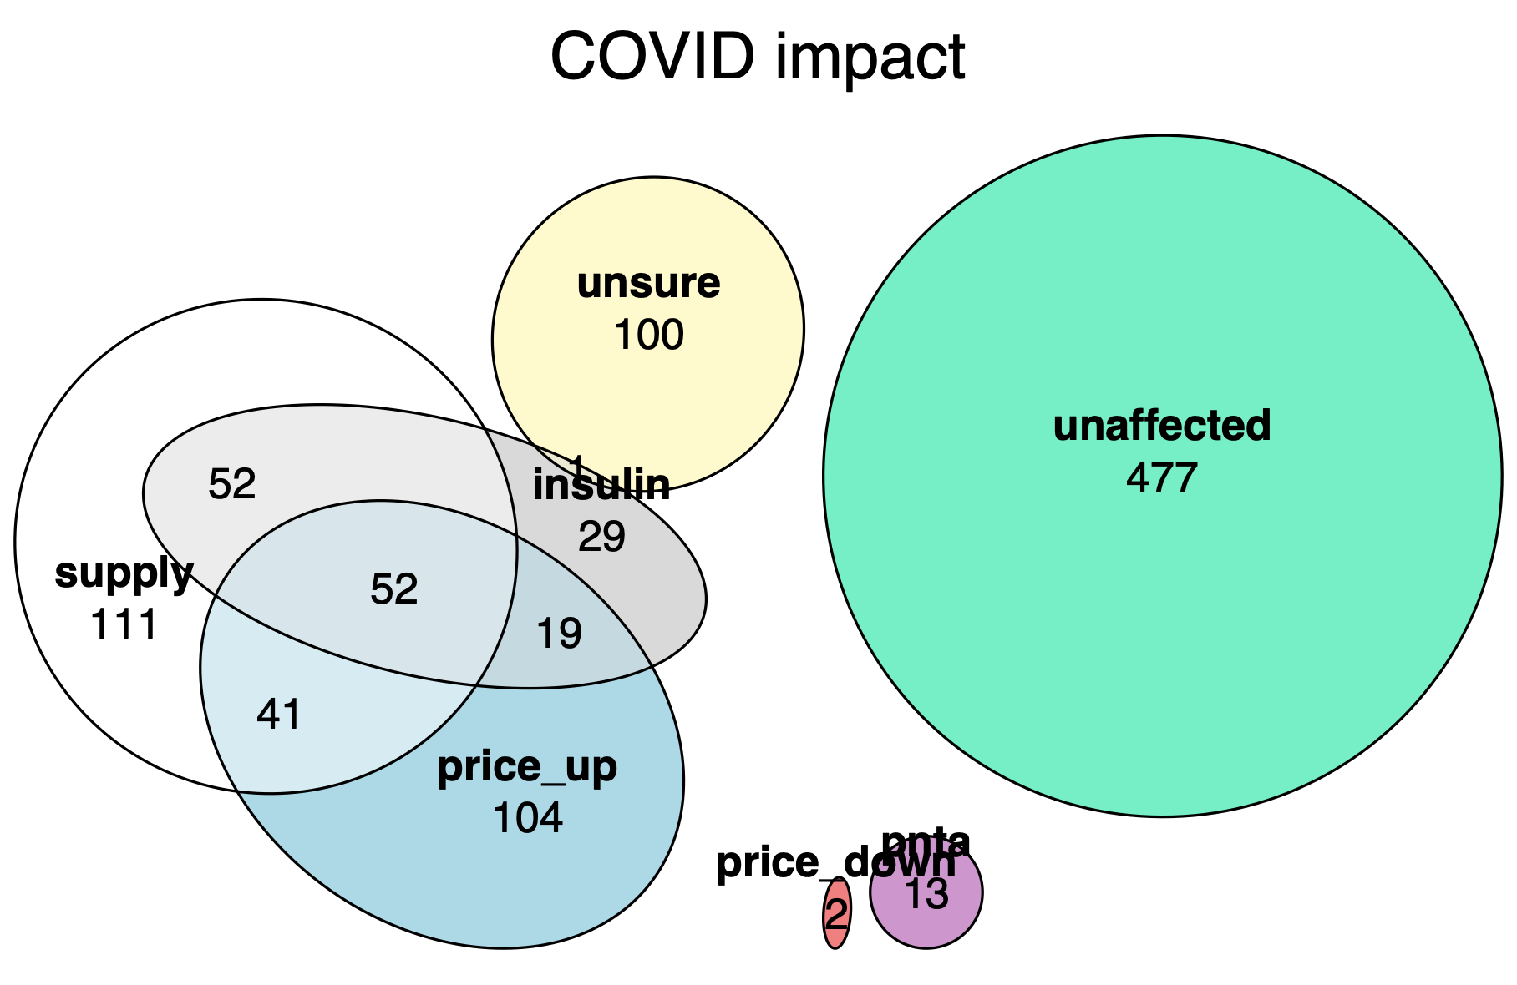
Silo analyses
Updated Feb. 2023 ✅
COVID-19 impact

Slide 14
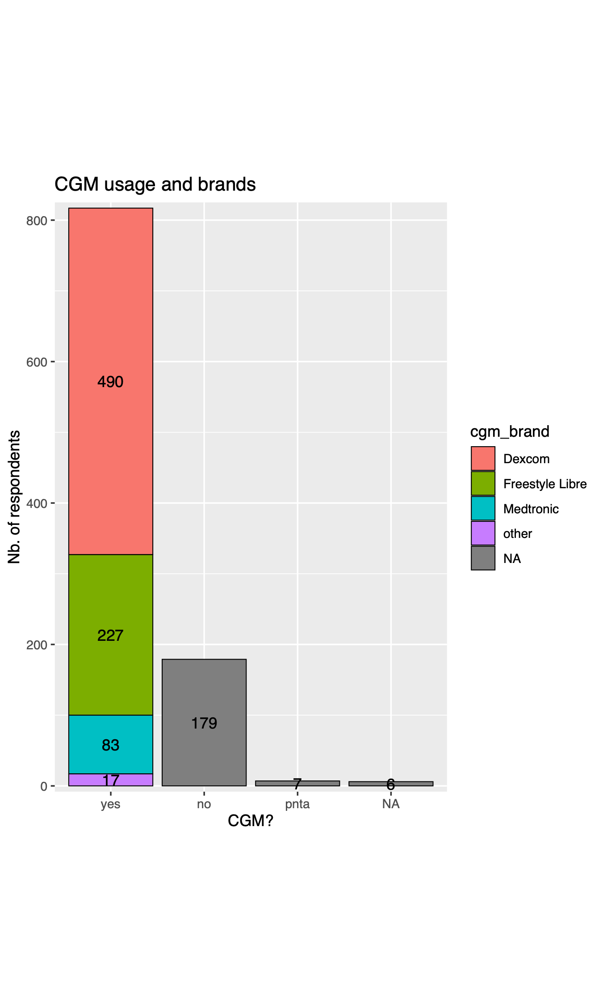
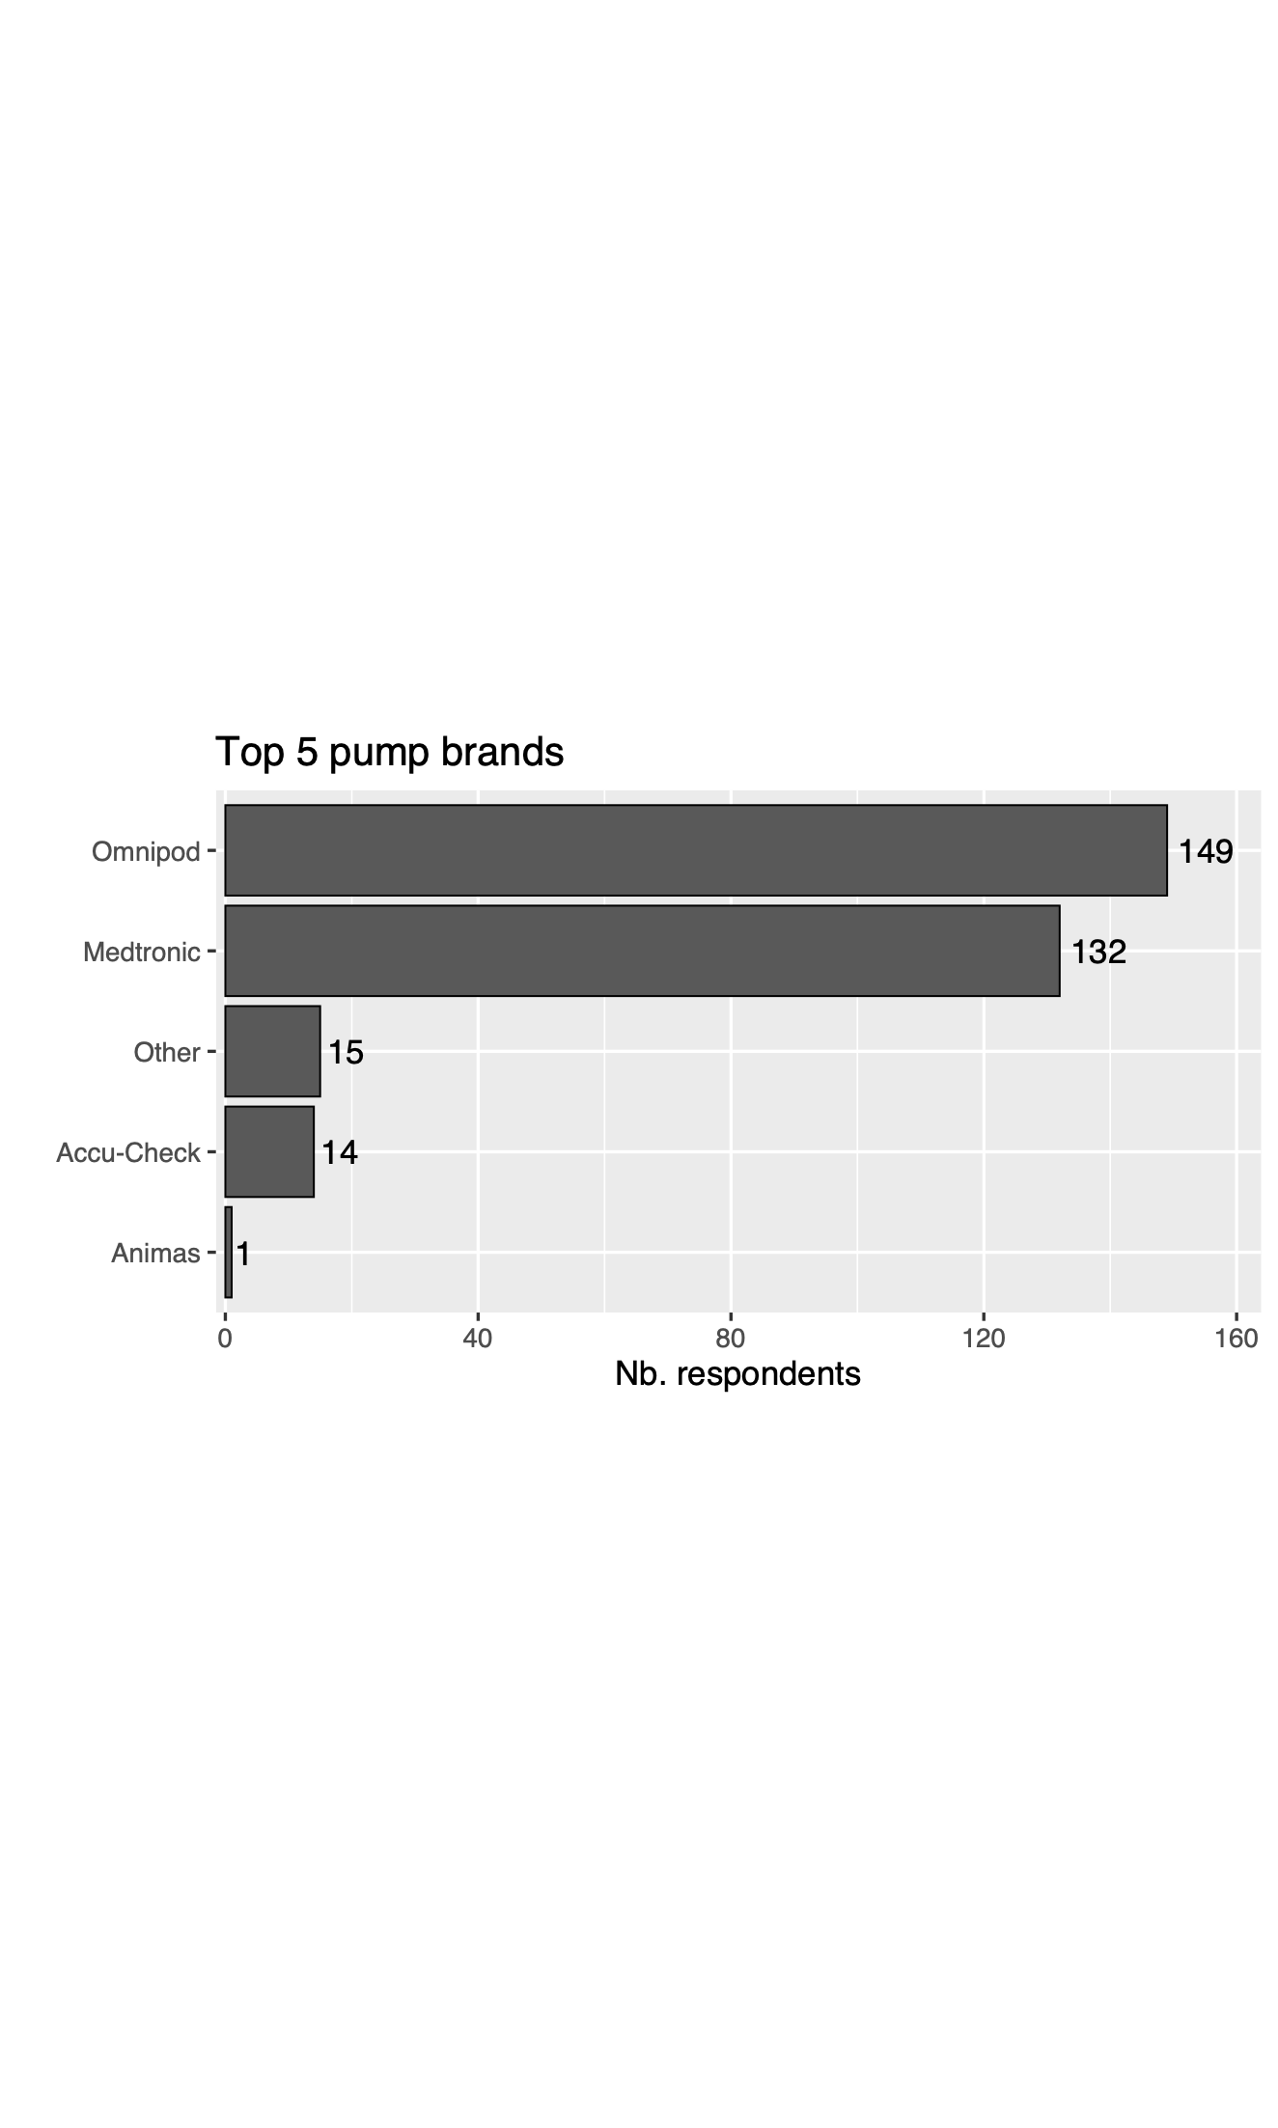
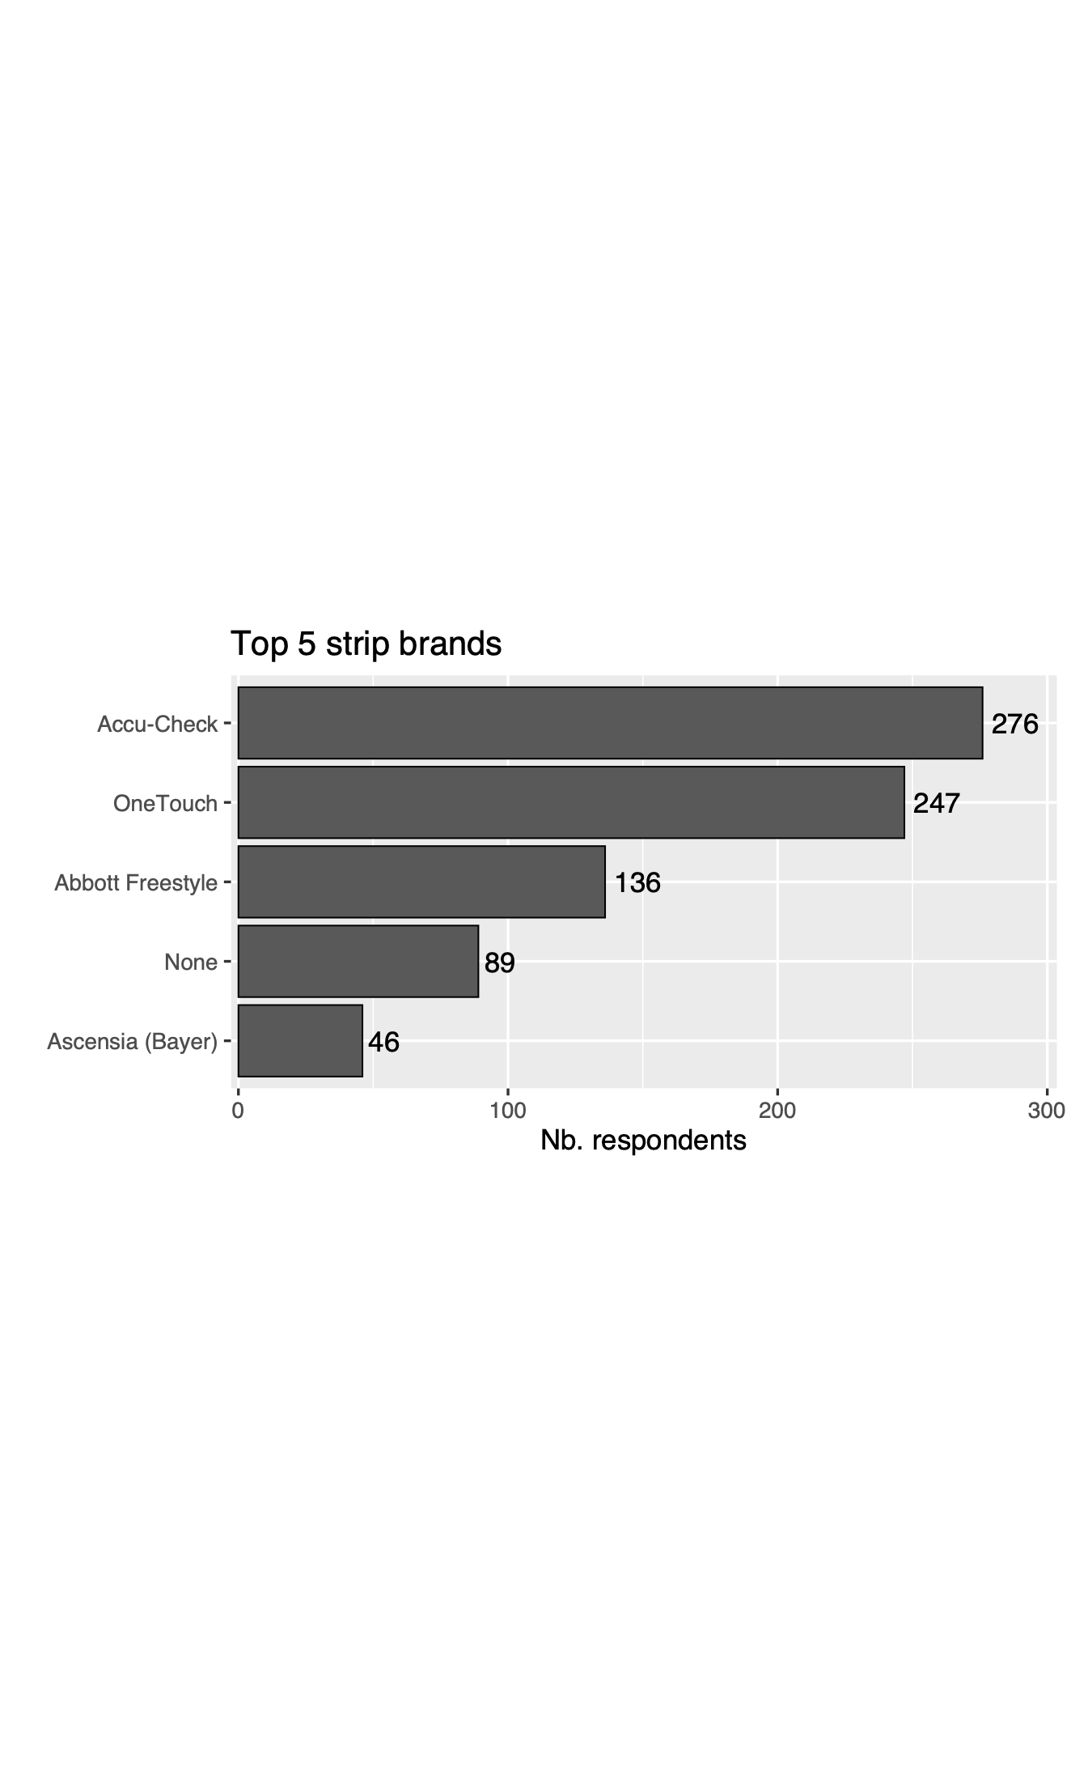
Silo analyses
Updated Feb. 2023 ✅
CGM, test strip, and pumps

Slide 15
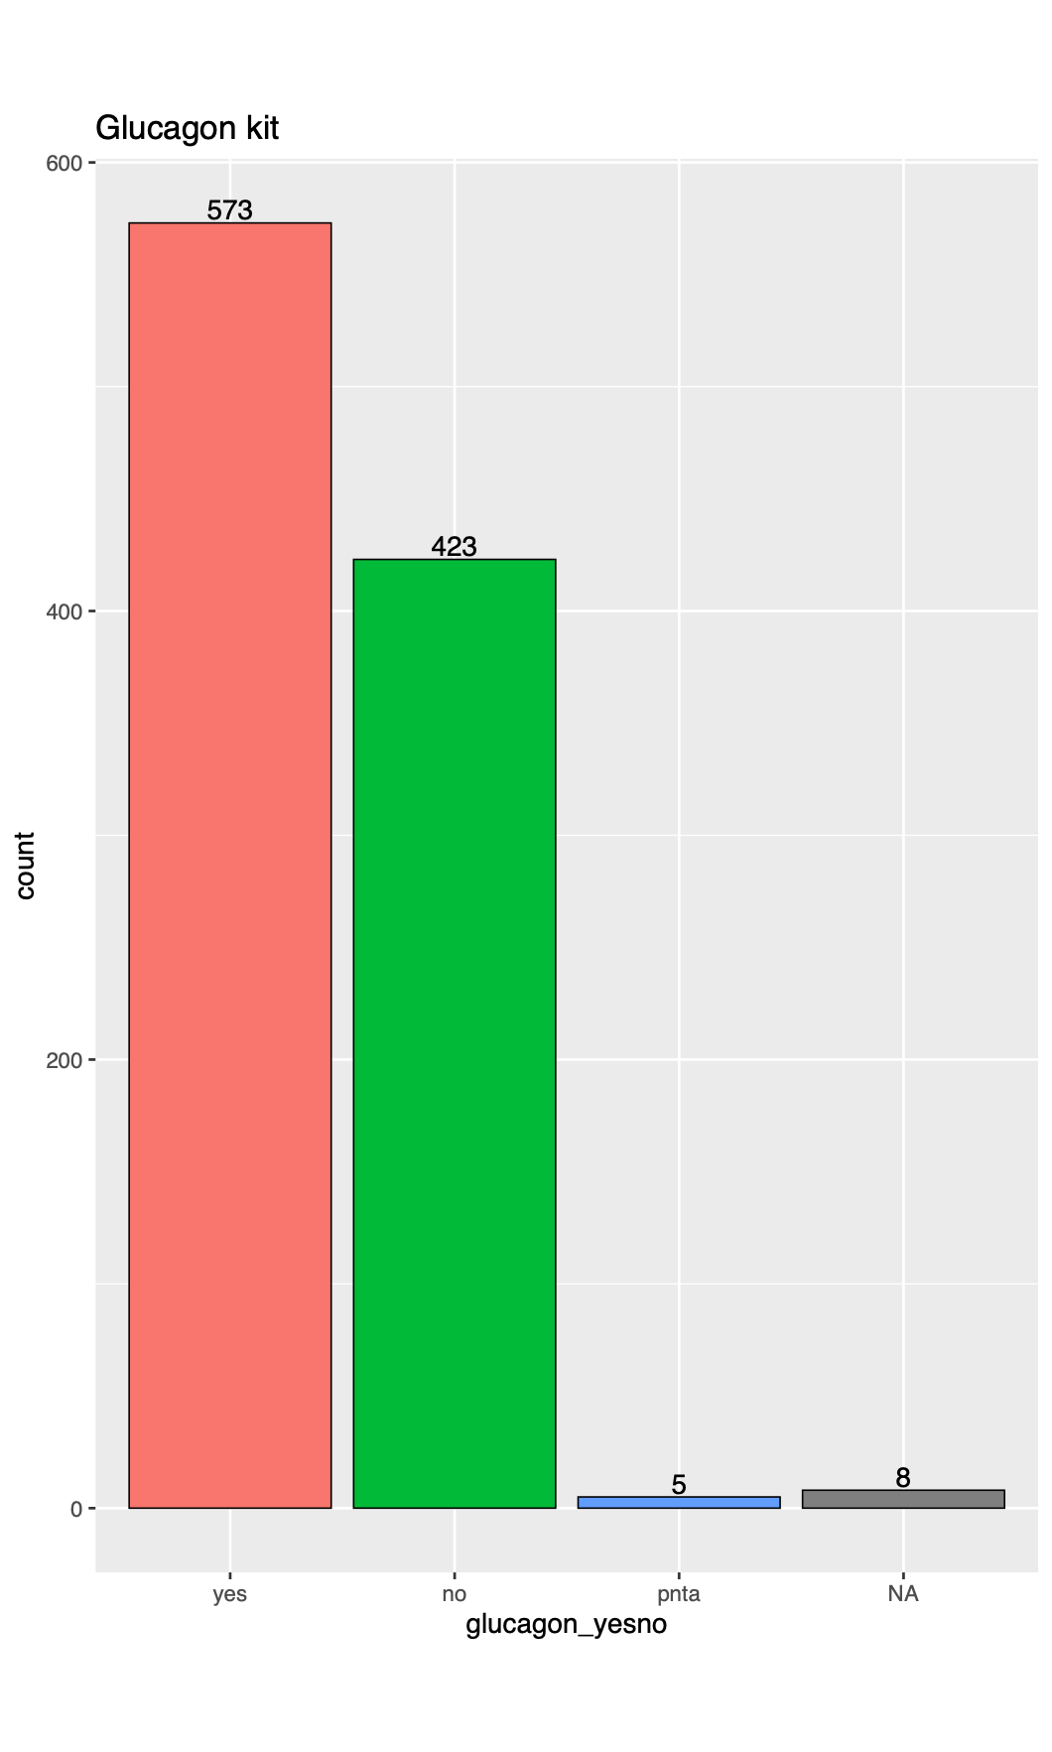
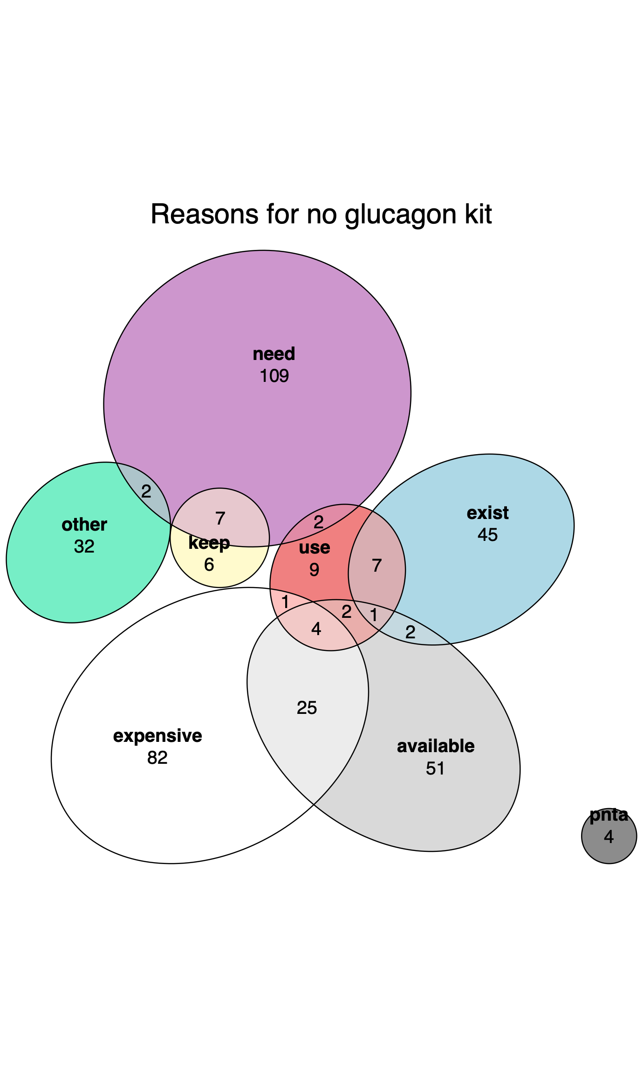
Silo analyses
Updated Feb. 2023 ✅
Glucagon kit

Slide 16
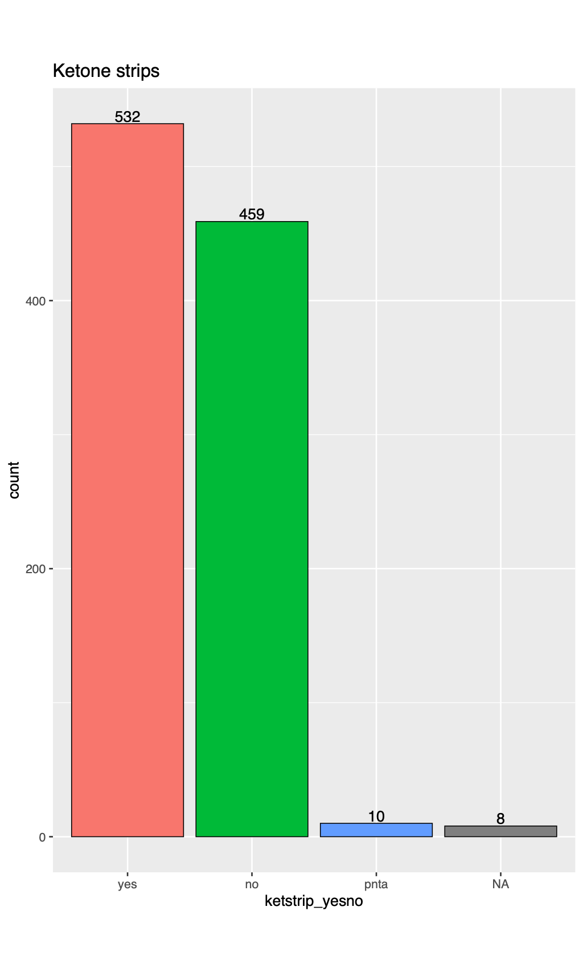
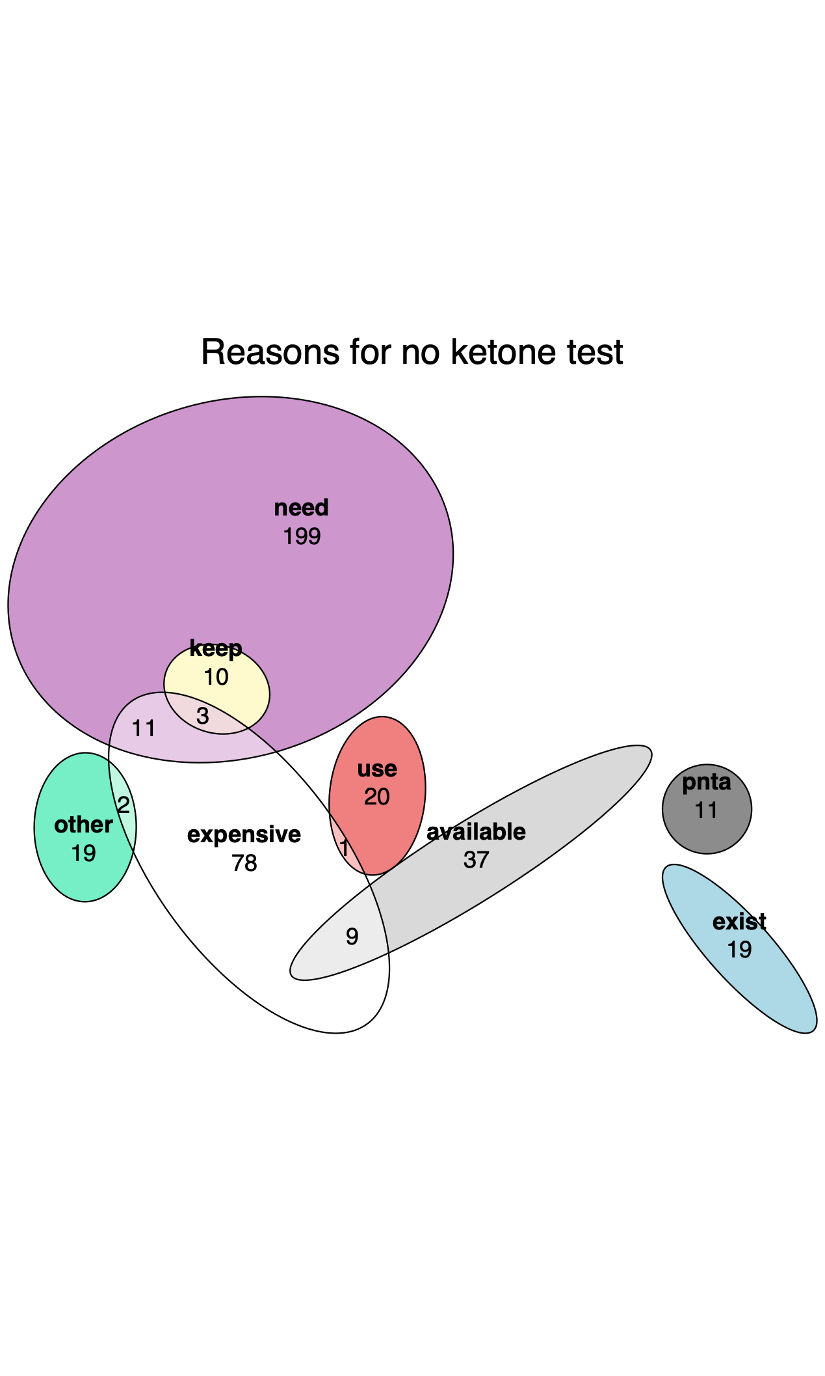
Silo analyses
Updated Feb. 2023 ✅
Ketone kit

Slide 17
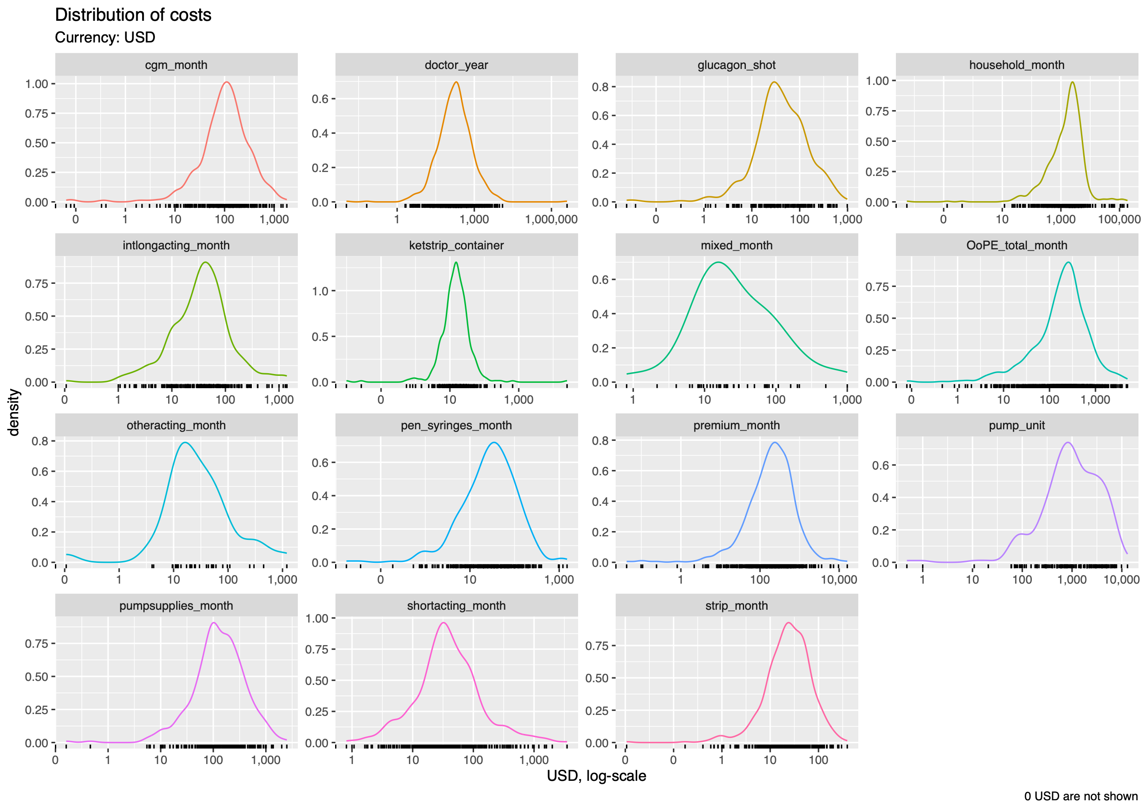
Silo analyses
Updated Feb. 2023 ✅
Cost distributions
outlier?
Note: 0 USD are not shown because lost by the log transformation: log(0) = -∞

Slide 18
Survey inconsistencies: OoPEs
Updated Feb. 2023 ✅
Cases where a respondent indicated costs for an insulin-management method they say they don’t use
Found in: - Insulin pen & needle - Insulin pump => See next slides
Not found in: - BG test strips - CGM - Glucagon - Ketone strips
Only two respondents: ID 807 & ID 903
Action: a) costs were removed for these events b) total OoPE/month were recalculated for these two respondents
Happens to be the manually-detected duplicates (that are removed)… so problem solved!

Slide 19
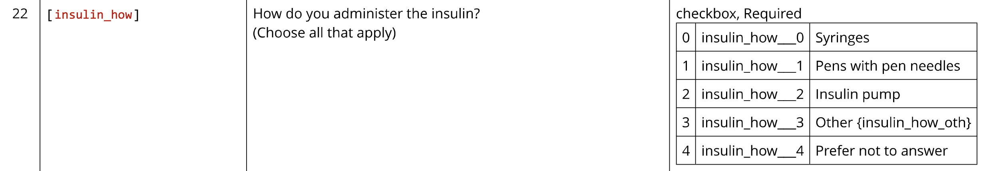
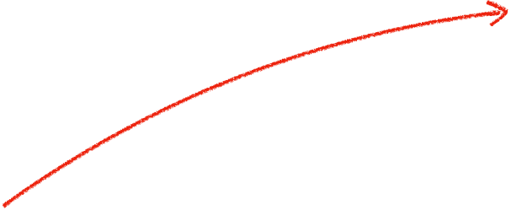

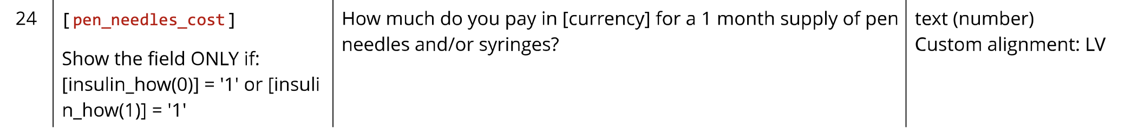
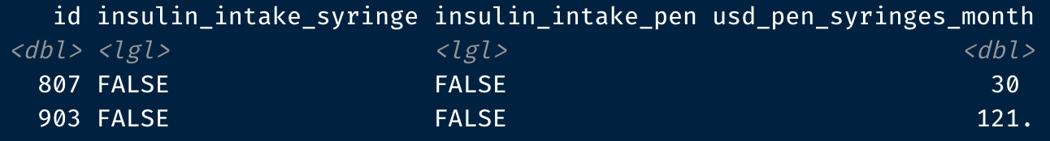
Survey inconsistencies: OoPEs
Updated Feb. 2023 ✅
1: Usage & OoPEs for insulin pen & needles:
Question of cost for pen & needles (#24) should only appear in the survey if respondents had indicated using syringes or pens with pen needles in question #22.
But two respondents could indicate costs in question #24 without having the necessary ‘checks’ in question #22.
Note: perhaps the fact that some respondents not being 18+ age still had access to the whole survey originates from the same survey logic problem.
I see in #24 that the values required for showing the field are named “insulin_how(0)” and “insulin_how(1)”, whereas those values in question #22 are named “insulin_how__0” and “insulin_how__1”. Could that be the reason why the survey logic did not work? If so, that problem is systemic.

Slide 20
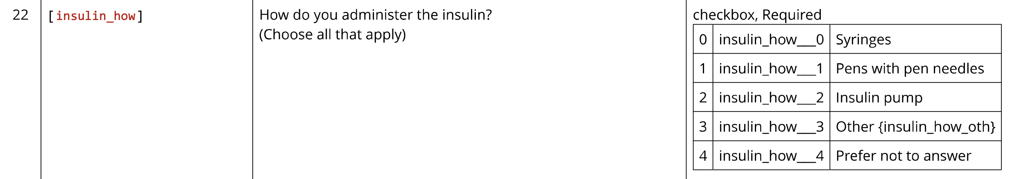
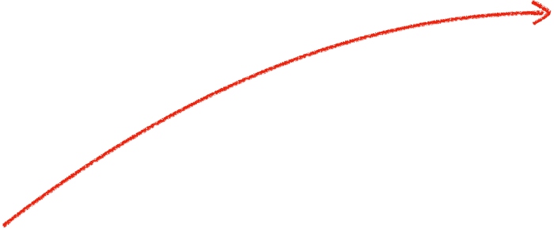

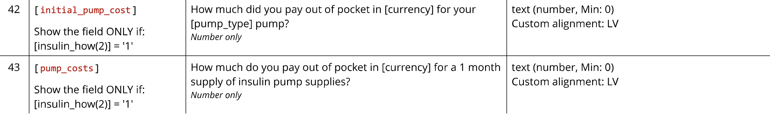
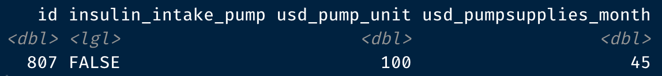
Survey inconsistencies: OoPEs
Updated Feb. 2023 ✅
2: Usage & OoPEs for insulin pump:
Same problem: - one respondent could indicate pump-related OoPEs (#42 & #43) without having declared using a pump as a insulin administration method (#22) - variable names are different between Q42-43 (“insulin_how(2)”) and Q22 (“insulin_how__2”).
Note that it’s also ID 807 as in the previous slide.

